Slide 1
Tips for Engaging readers and adding tension in writing
October 19, 2013
Frank Dahlman - fdahlman
Information from Writer’s Digest, Fiction Factor, and the Now Write book series

Slide 2
Who am I
Co-ML for the Naperville region
Teacher and Department Chair– 9 years as English/Social Studies teacher
3 time winner of Nanowrimo
No PhD, law degree, or published works to my credit
Father of three, husband to Mary Poppins.
Rabid fan of Deadliest Catch and hockey, and an eater of chicken wings.

Slide 3
Tim Yao
Nanorimo
Naperwrimo
The Journey

Slide 7
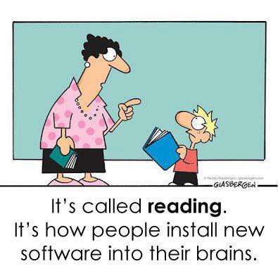
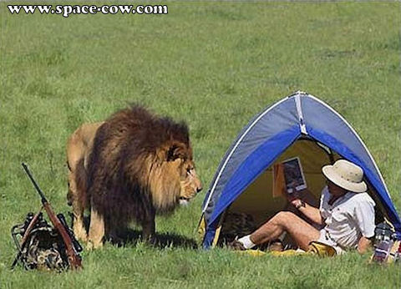
Engaging your readers

Slide 8
An engaging story starts with you
If you are bored, disinterested, not compelled to finish a scene, etc. You reader will probably feel the same.
You feel that way for a reason, listen to your conscience (or your muse as Todd would say).
What do we do?

Slide 9
An engaging story starts with you Thank you Todd!
Have a reader in mind, or type of reader. Write the story you know they would love to read.
Think about how you could make that person want desperately to read every single page of your book. What can you put on that blank page that will make her devour it? And what can you put on the next page that will make her flip to it with such alacrity the ivory paper begins to tear near the binding? Choose a tough-minded friend, critic, student. Choose an honest one. Someone whose taste you respect and share, but not someone who would flatter you or laugh at just anything. Adam Gidwitz, author of A Tale Dark and Grimm

Slide 10
Topics for today
Where does tension and engaging readers begin?
Character
Conflict
Tools for tension
Questions
Setting
Time
Stakes
Complications
Dilemmas
Plot Twists
Pacing

Slide 11
Characters
Thank you Katherine!
The most important part of tension is characters.
Your reader has to care if they succeed or fail.
The reader must empathize with the characters situation.
Know their strengths, weaknesses, wants, and flaws.
Long story short….know your protagonist well!

Slide 12
Conflict
Tension revolves around conflict
Character vs. character
Character vs. nature
Character vs. society
Character vs. self
Have your conflict solid before you write.

Slide 13
Exercise
Purpose: to generate ideas, or ways at looking at tension and engaging readers that will help you in November.
Break up in to groups by genre.
Create a protagonist, antagonist, and if needed a side character.
What are their wants, needs, traits, character flaws?
How could you develop this conflict?
What are scenes you can use to set up this conflict?
Keep this..you’re going to use it.

Slide 14
What is tension?
Tension is a reader’s feeling of suspense.
There is no terror in the bang, only in the anticipation of it. -Alfred Hitchcock
Typically Act 2 of our book.
Rising action of your story.
There are many tools at our disposal we can use to help raise tension as we write.

Slide 15
High Stakes
Can be physical or emotional
Danger/death
Losing the girl/guy
Does not have to be end of the world, but something dramatic and major for the character. Enough that they would do anything to prevent it.
Allow your character to fail to raise the stakes and increase tension.

Slide 16
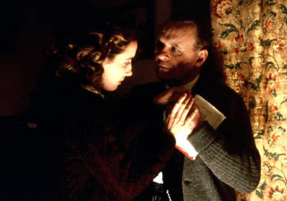
High Stakes
Example: Hunger Games – Life or death struggle between teenagers.
“Remains of the Day” (emotional) Potential loss of someone he secretly loves

Slide 17
Setting
Easy tool to use to create tension
Graveyard and abandoned building are cliché but we know what to expect.
Cliché can be your friend as long as you don’t use it as a cliché.
House by Ted Dekker
The Graveyard Book by Neil Gaiman
In romance it can be useful as well.
Weddings, funerals, foreign land.

Slide 18
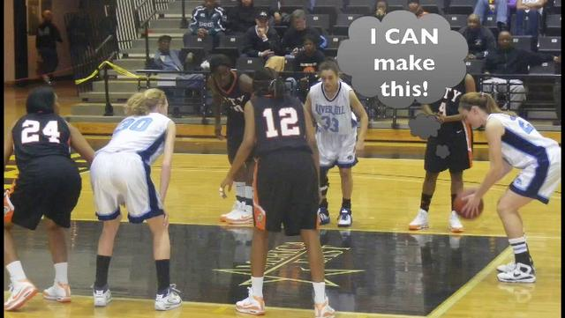
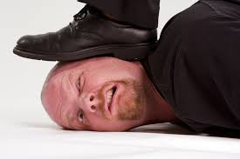
Apply pressure

Slide 19
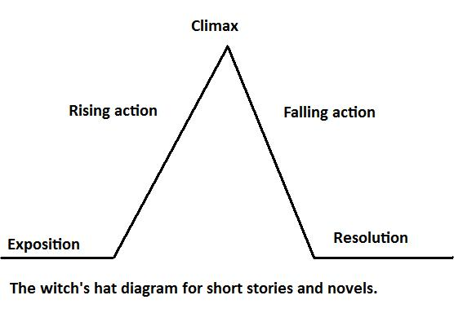
Apply pressure
Change equals tension.
Make it seem like the protagonist cannot succeed.
Bend but not break.
Ramp up the pressure as the plot progresses.
The witches hat plot diagram
Vonnegut’s shape of stories

Slide 20
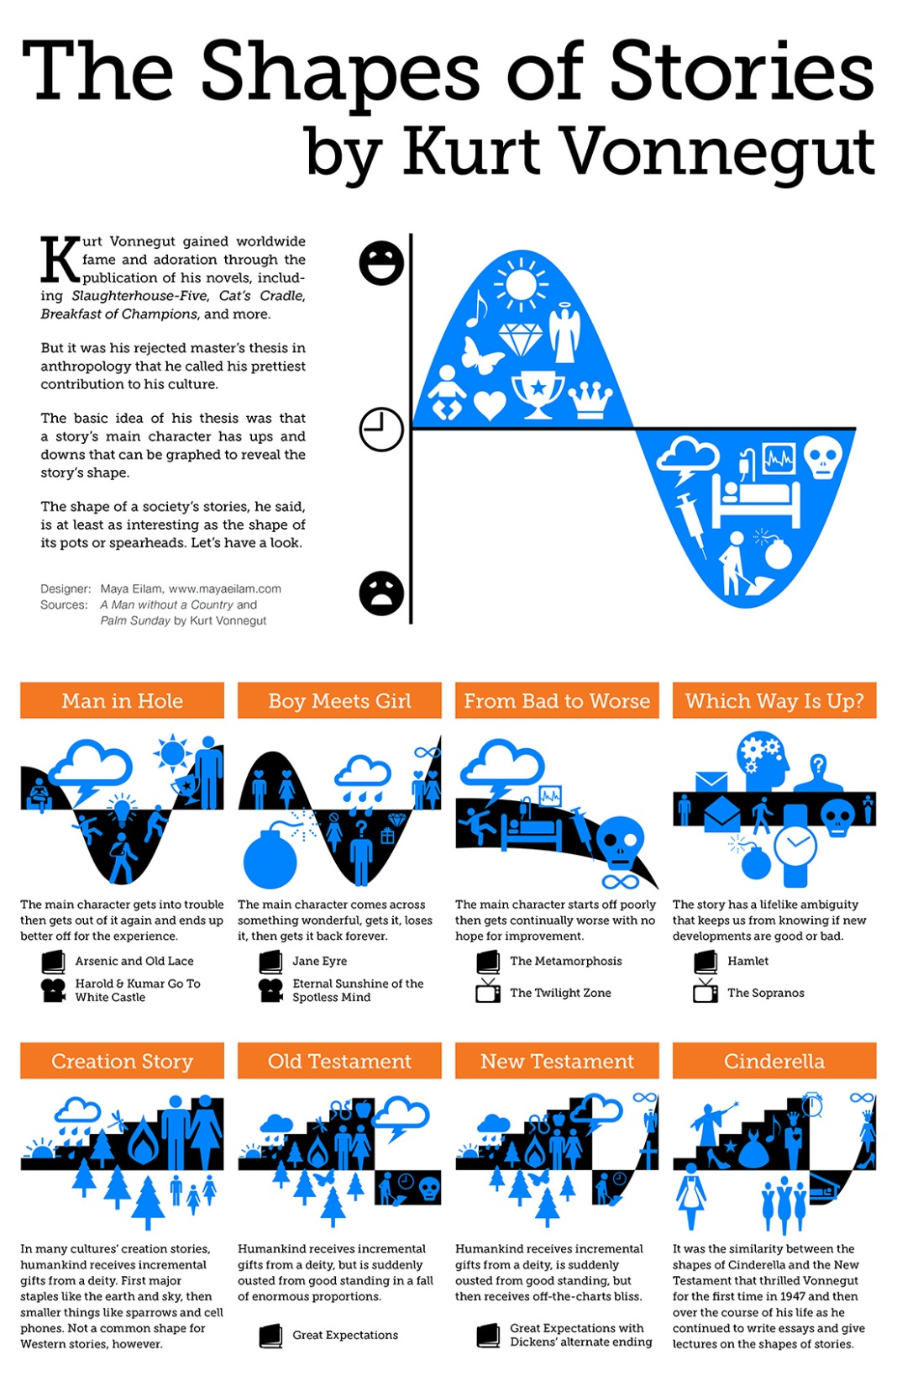

Slide 21
Make their life painful!
Antagonist throws things at the protagonist
Awkward tests, challenges, and choices
They should seem like lose-lose situations
Emotional tension is from something outside of relationship.

Slide 22
Make their life painful!
This is where protagonist and antagonist usually differ
Antagonist will usually cross lines without a second thought
Protagonist will often be unwilling to cross lines
Example: Spiderman – save bus full of people, or his girlfriend.

Slide 23
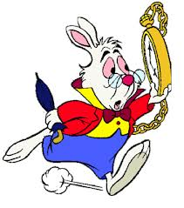
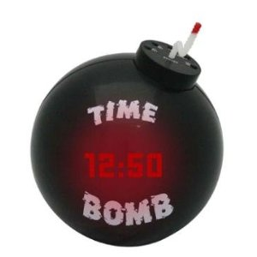
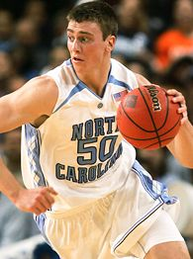
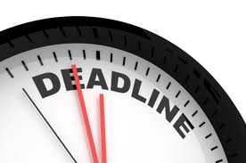
Time

Slide 24
Time
Use time constraints to add tension.
Work against the clock or something dire will happen to protagonist.
Example: the television series “24”
Tom Clancy’s The Sum of All Fears. Have to get to Super Bowl before nuclear bomb goes off.
Opening to Ted Dekker’s Saint. One hour to complete assassination or they will kill his wife.

Slide 25
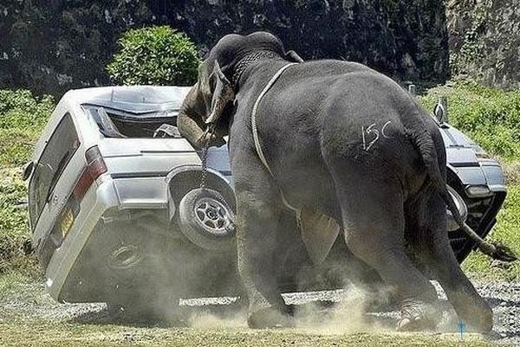
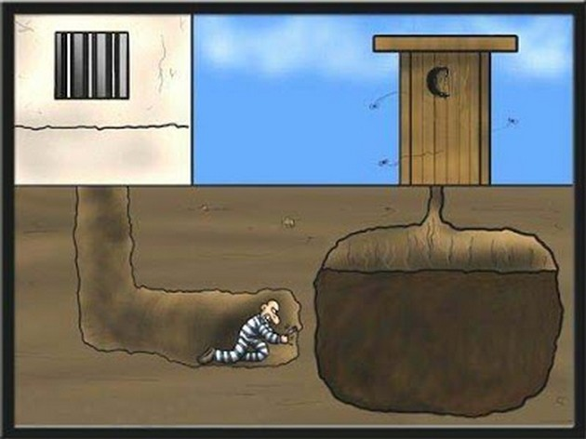
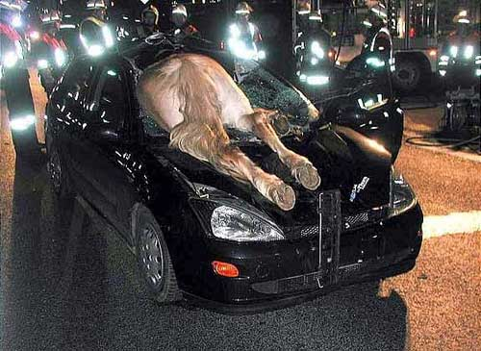
Complications

Slide 26
Complications
This is a piling on of problems or issues.
So many potential issues that could cause protagonists world to come crashing down

Slide 27
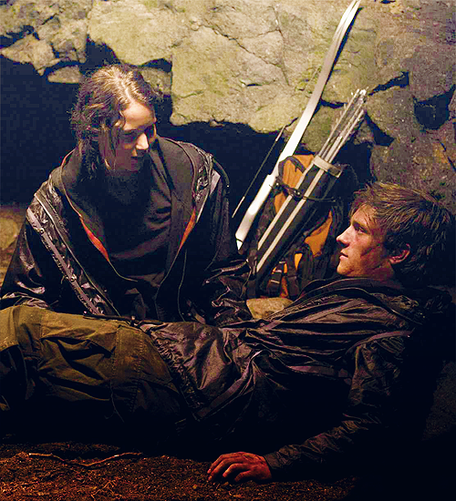
Complications
Hunger Games:
Katniss not sure who to trust, doesn’t trust Peeta but now can win with him, has to look like she loves him, does he really love him or is it an act, etc.

Slide 28
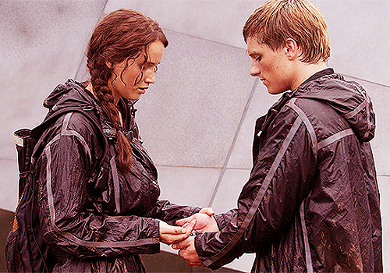
Plot Twist
No one can foresee all potential problems in reaching a goal.
No plan ever succeeds without a problem
You need to find problems that are legitimate, but seem to come out of no where.

Slide 29
Plot Twist
A good twist can get a story really going
“The Most Dangerous Game” we find out the animal being hunted is man/main character.
Divergent by Veronica Roth – Tris leaves her faction to join the dangerous one. Then in the middle of the book she finds out she’s divergent. And the craziness is cranked up.

Slide 30
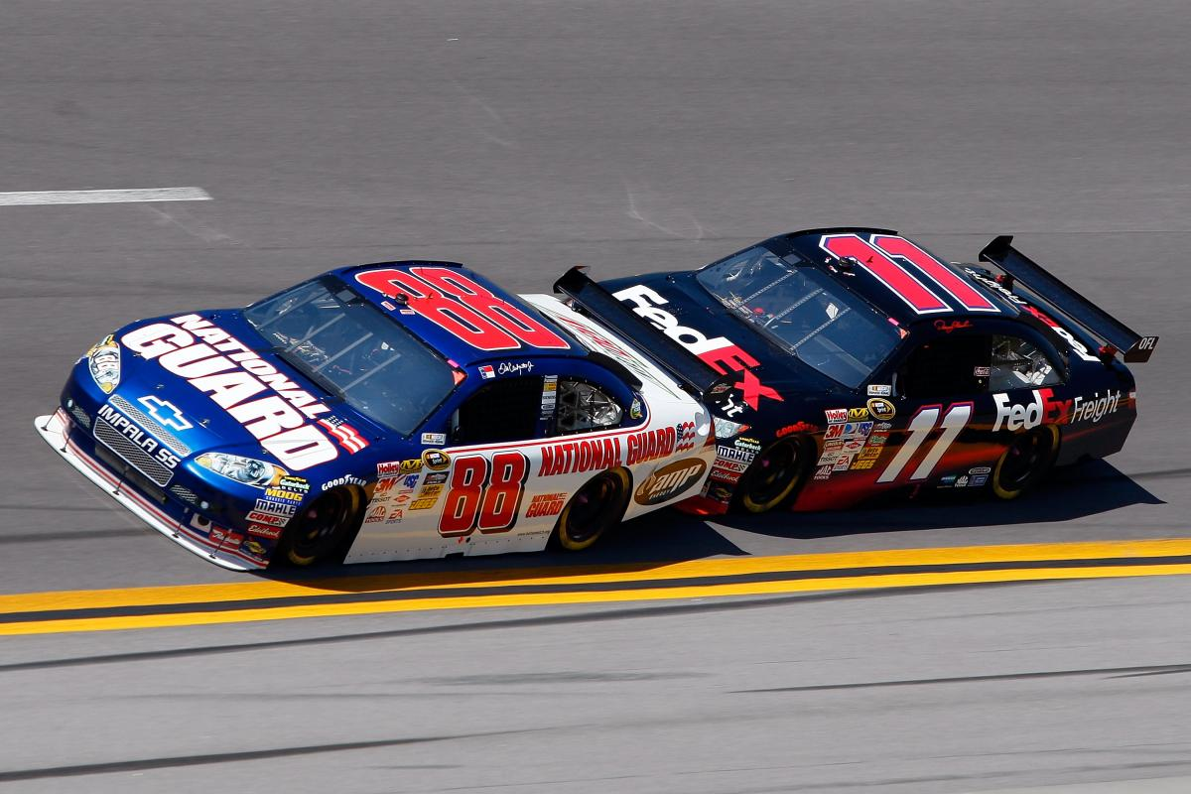
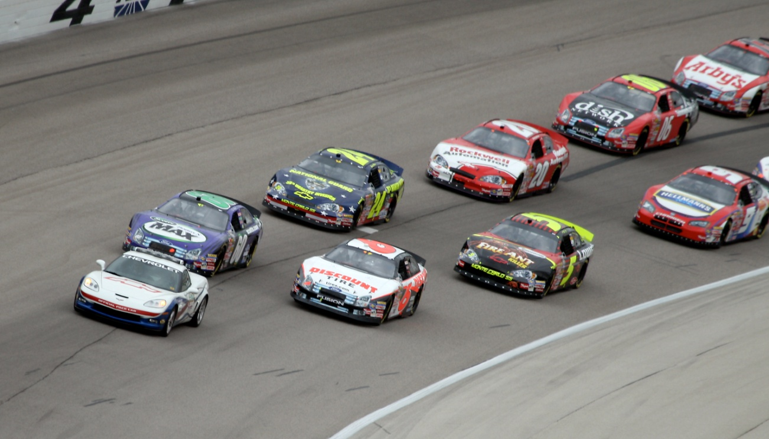
Pacing
This is you!

Slide 31
What is pacing?
Thank you Roger!
Pacing is the rhythm of the novel.
It is also the rate at which your reader will read the book.
You can plan pacing and/or should be aware of it as write your book.
Use scenes to dictate pace.
Inhale scenes with high tension and suspense
Exhale scenes to give your reader a breather.

Slide 32
Give your reader time to breathe
You can’t have high tension all the time
Readers can get exhausted or frustrated if it never ends for your protagonist

Slide 33
Give your reader time to breathe
Let it ebb and flow. Know your genre.
Romance: Requires more breathers than other genres. Emotional tension is something readers like to take time to explore. (Dinner with friend, a walk)
Thrillers: Can stay ratcheted up more, but transitions allow us to move in time and place, and give your reader a moment to catch their breath.

Slide 34
Exercise
From Jane Cleland-author of the Josie Prescott Antiques Mysteries
The middle of our book tends to slow down
What does your protagonist see, hear, taste, smell, and touch that would startle or frighten him. her.
Use your characters senses to add three plot twists in to the middle of the book.
Now what are your breathers going to be?

Slide 35
General Tips
Begin your story as late as possible.
Have a lead that creates curiosity and questions.
Have a big dramatic question you are focusing on.
Will she survive?
Who are his parents?
What would mankind do if confronted with an alien race that only wants to destroy them and not communicate.
Do not overpopulate your story.

Slide 36
General Tips
Is your setting appropriate and does it help create tension?
Are the stakes high enough? Without high stakes a person would not go through the problem.
All this together means nothing if you do not have a reasonable, believable, satisfying ending.
Get ahead, you will have a better chance to finish.
Know the scene/goal for the day for writing. It drives my word count.

Slide 37
Exercise
Now that you have characters, and a pacing idea….how is it going to end?
What is the climax of the story that resolves the main conflict.

