Slide 1
NaNoWriMo in a Nutshell
- or -
the whys & hows of writing
your novel in one month
Notes:
DESCRIPTION
The whys & hows of writing a novel in a month. Bring your laptop or notebook and pen to this highly interactive and entertaining workshop to gain a better understanding of how NaNoWriMo works and how you can succeed in writing your novel this November. There will be (small) prizes!
PREPARATION:
Attendees –Bring some way to write (laptop, or notebook and pen)
Presenters - Bring this presentation as well as a way to project it (thunderbolt to VGA adapter), easel and LARGE post-its, historical NaNo prizes, chocolates, Props: Box of Doom, Novelista poster, NaNo USB bracelet, our self-published books (including anthologies), laser pointers, VGA adapter (so important I said it twice)
Timing: this will be up at the beginning, perhaps while we’re being introduced/introducing ourselves
START MUSIC, THEN GO TO NEXT SLIDE

Slide 2
Category One:
Why write your novel in November?
Notes:
MUSIC, TIM RUNS, CB WRITES answers on white board (tick marks); take pictures of answers before erasing
CB note how Tim runs for my turn

Slide 3
People write their novels in November because:
They need the motivation
Writing in a tight timeframe forces you to turn off your internal editor
It’s an enjoyable way to meet other writers
It’s a great way to get that first draft written
There’s a built-in deadline
NaNo is fun!
Notes:
1- (CB) they’ve always wanted to write one, but could use a boost. National Novel Writing Month has both carrots (Both locally and nationally, there’s the opportunity to get loot, aka prizes! We’ll talk about some of those later) and sticks. For example, if you sign up and tell all your friends (highly recommended!), think how embarrassing it will be if you don’t keep at it!
2- (Tim) picture of internal editor in envelope
3- (CB) you can always use more writer friends; there are opportunities, both online and at local events, to meet new writer friends.
4- (Tim) because ...
5- (CB) Some people are deadline-driven. It’s amazing how much more I get done if I have a deadline.
6- (Tim) we come back year after year
National Novel Writing Month offers both carrots and sticks. Signing up and telling your friends and family that you’re going to write the first draft of a novel in November invites both skepticism and support, either of which can be motivating. (Bart always asks: how many words did you get today?) Do you want to tell people you quit partway through?
Also, in the NaNoWriMo community, you have friends (or soon-to-be friends) in the same boat.

Slide 4
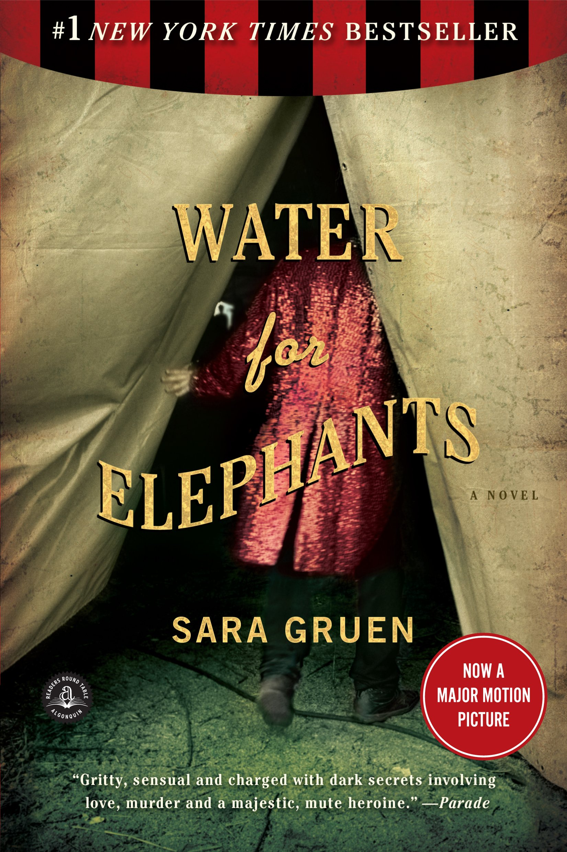
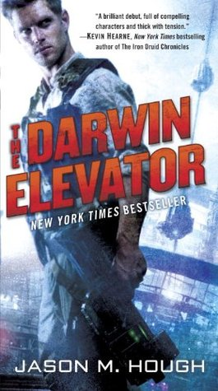
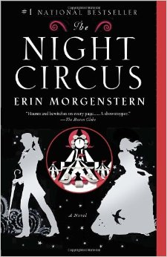
Published Novels that were drafted during NaNoWriMo
Notes:
Examples of pro writers who use NaNoWriMo to draft their novels:
Mary Robinette Kowal, Jason Hough, Erin Morgenstern, Stephanie Perkins, and Sara Gruen, as well as many others. They’ve found November useful as “focus time” for pushing the world aside while finishing their novel.
ADD ANECDOTES? See if there are author comments on Nano site, maybe in pep talks

Slide 5
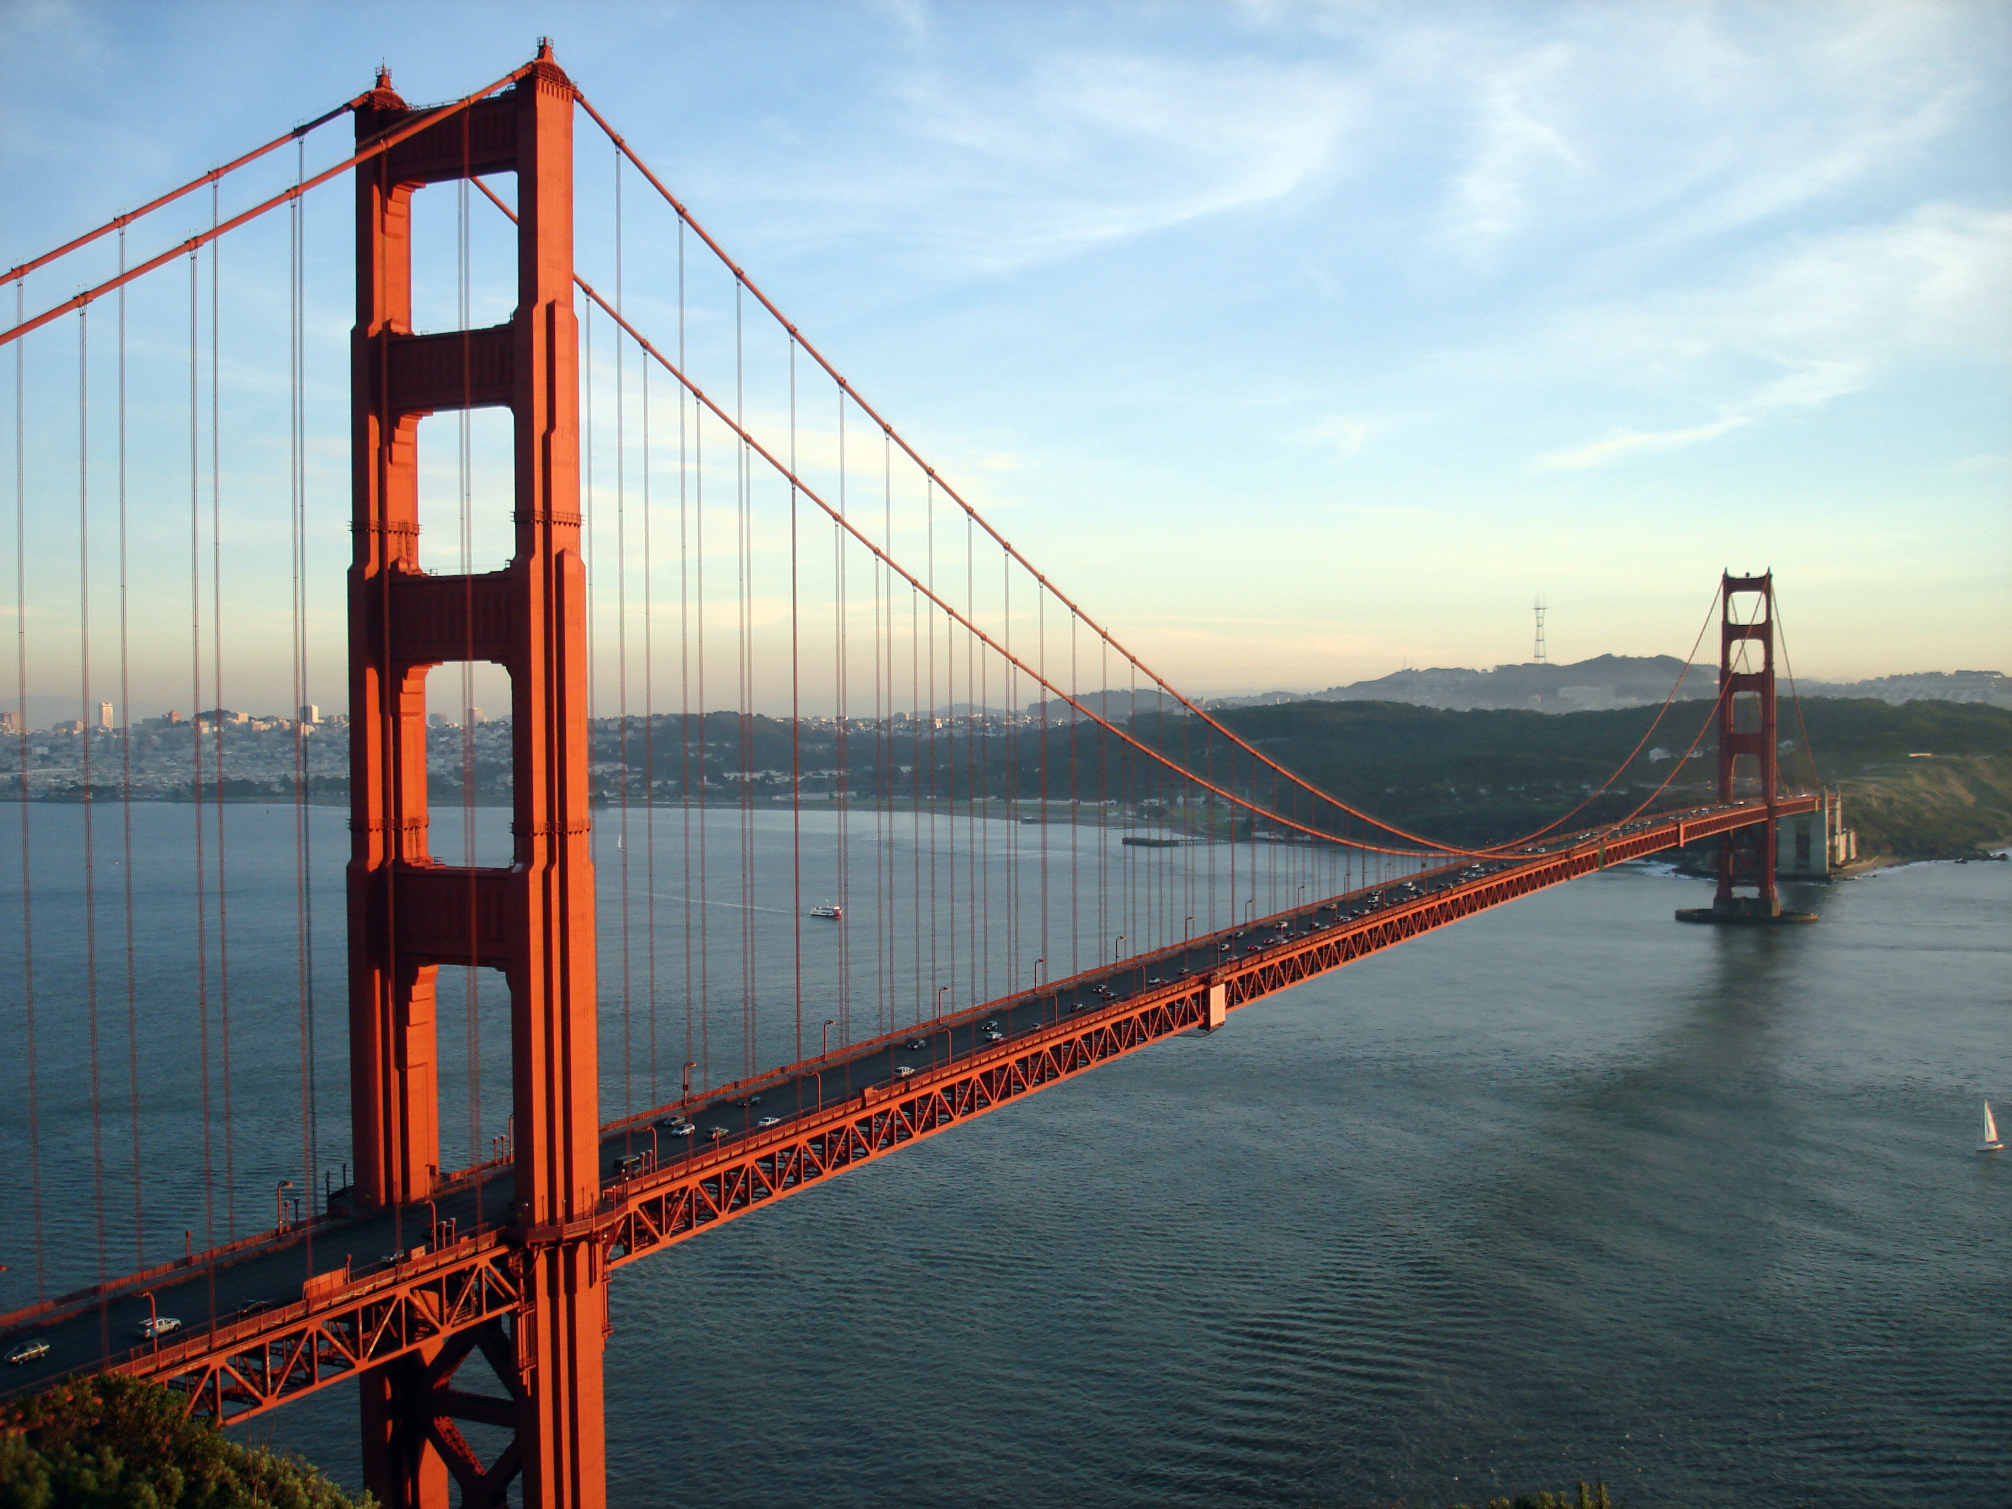
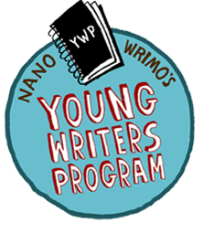
So...what is National Novel Writing Month?
1999
2000
21 writers
Bust!
November
Or
(
)
2013 :
x 310,000) + (89,500 x
Notes:
- NaNoWriMo is short for National Novel Writing Month; it began in July 1999 in San Francisco with 21 participants, mostly in their 20s, who mostly started Besides, they thought, as novelists, that they would find it easier to get dates than as non-novelists.
- It moved to November the following year (to take advantage of the miserable weather).
- In 2013, the folks at NaNoWriMo tallied 310,000 adult novelists and 89,500 young writers.
stats: hundreds of thousands of participants each year; regionally, at least a few hundred in the Naperville region representing the cities and suburbs west of Chicago
Locally, 154 winners out of 554 participants comments - Tim

Slide 6
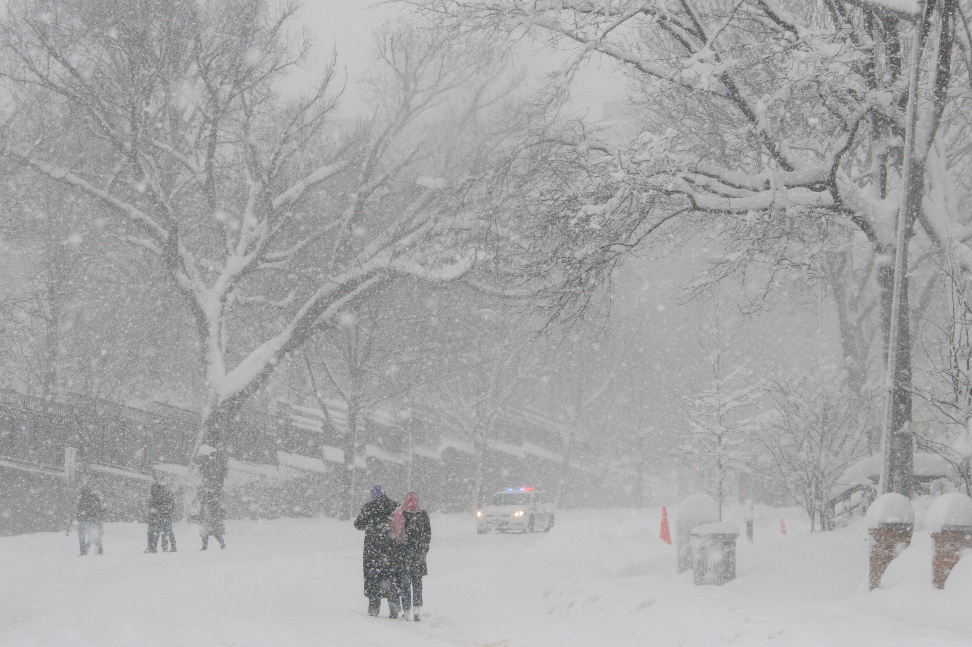
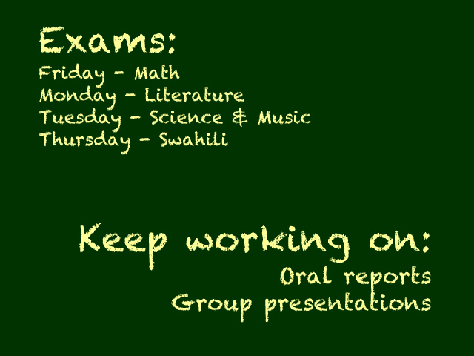
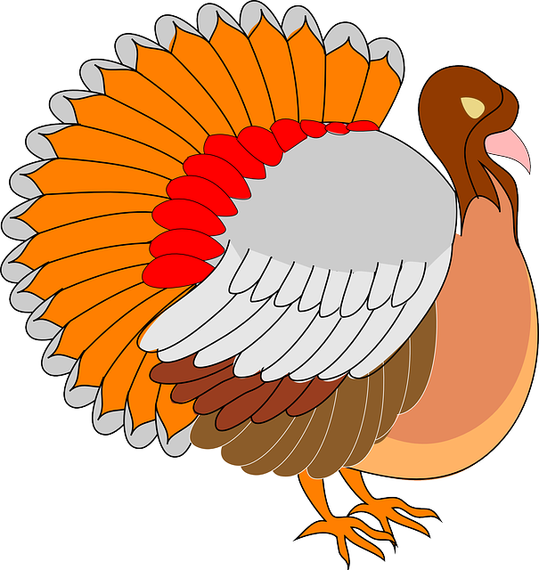
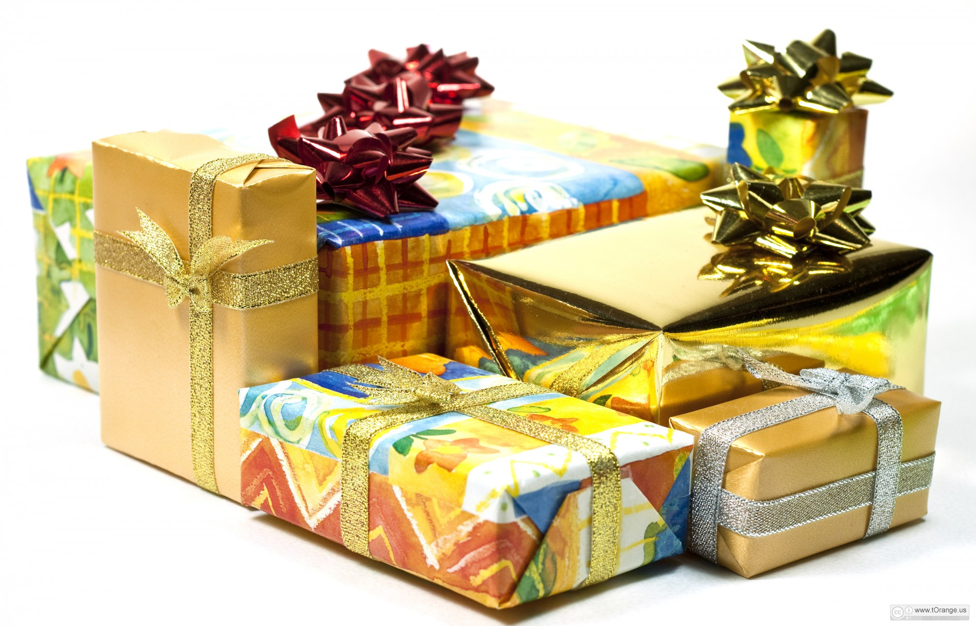
Timing is everything*
?
?
?
?
Bad weather
Big school projects
and exams
?
?
Work assignments come due
?
Thanksgiving
Shopping for holiday gifts
*Wait... who thought November was a great month to write a novel???
Notes:
November sucks as a month to do this
Click 1: bad weather
Click 2: work assignments, because everyone wants to get the big stuff out of the way before the holidays
Click 3: School projects/exams
Click 4: Holiday shopping starts to become an issue
Click 5: Thanksgiving – a lovely time with lots of cooking, housecleaning, and company possibly showing up.
Click 6: Punch line

Slide 7
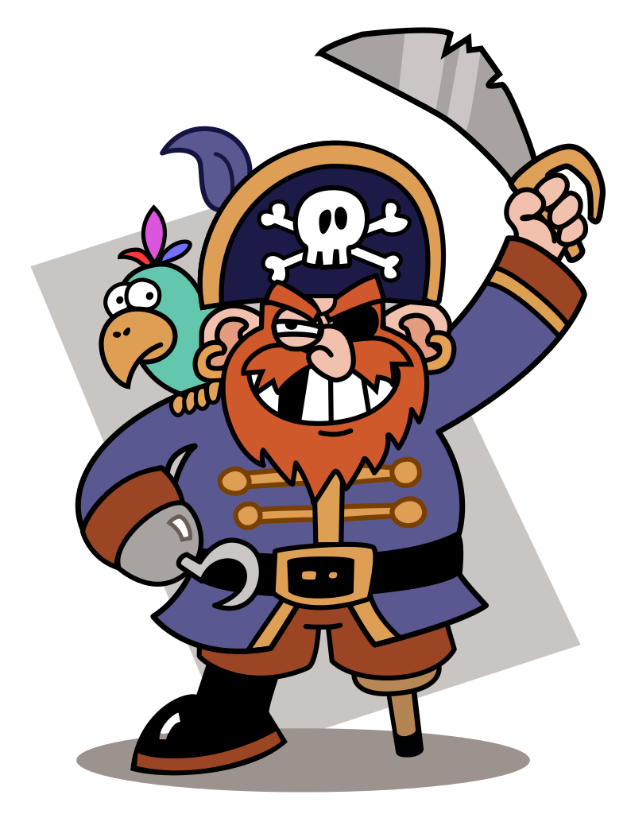
The “Rules” *
Write at least 50,000 words of your novel in November
Start your novel from scratch November 1st
Be at least 13 years old
Validate your word count at nanowrimo.org before the end of November 30
Start your novel from scratch November 1st
*Or...you can be a NaNo Rebel and ignore any and all of the above (as these may be more guidelines than actual rules)
Notes:
Note: There used to be a rule requiring you start from scratch; but now you are allowed to add onto an existing work. And there are NaNo rebels who use the motivation by eschew the other rules.

Slide 8
NaNoWriMo Website
Sign up at nanowrimo.org
Notes:
CB: At start: Ready to write a novel page is up
Click 1: red rectangle; click on this button which brings you to
Click 2: welcome writer page; which you can
Click 3: arrow to preferred username. Mine is ceebee. Fill in the other fields and choose your time zone; tell them you’re at least 13 and have read the Terms and Conditions

Slide 9
NaNoWriMo Website
Keep track of your progress
Notes:
You can refresh your stats whenever you add words. During November a link appears (usually in the upper right of the page) and you can update your total.
Many people find the graphs motivating!

Slide 10
NaNoWriMo Website
Create a support system and keep in touch
Notes:
Find buddies, near and far
Does this go better in combination with or near the local events/ Naperwrimo pages?

Slide 11
NaNoWriMo Website
Inspiration
Get help from (or procrastinate with) fellow writers in the forums
Notes:
CB
Slide comes up with Inspiration screen shot
On click: refer to the various forums which Tim will talk about in more detail

Slide 12
NaNoWriMo Site Forums
Reference Desk
Plot Doctoring
Adoption Society
Genre Lounges
NaNo Artisans
And many more...
Notes:
TIM
Click 1 – Reference desk; Tim gives good examples here (whales). (If CB chimes in, maybe something about: If you want ideas for exotic diseases or to know how the French school system works, post your question in the Reference Desk forums, where you might find a surprise expert!)
2- Plot Doctoring
3- Adoption Society
4- Genre Lounges
5- NaNo Artisans
6- many more, and move to the next slide (Regional forum discussed right after this slide; lead in to that)

Slide 13
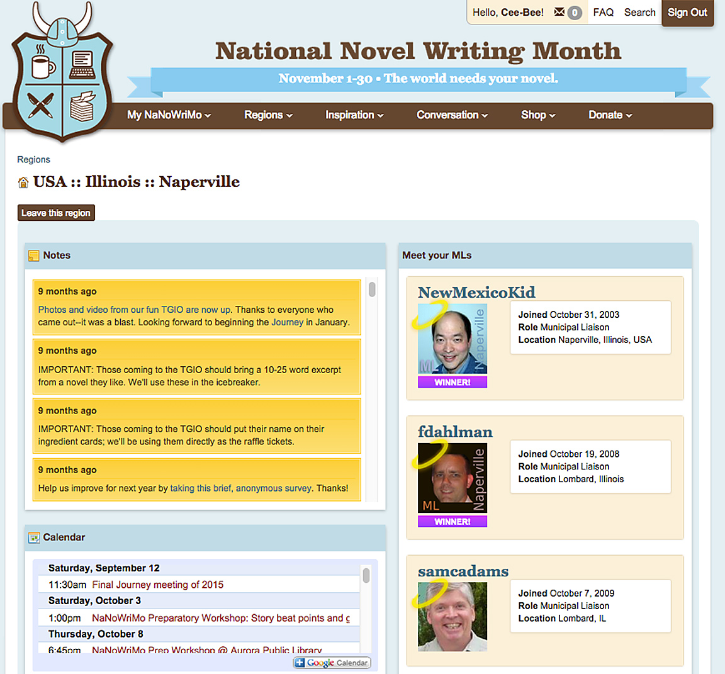
Find local events
Look for your closest region in the Regions Directory, sorting by country, state, and town
Along with contact information, there will be messages, a calendar of events, and other information
Notes:
TIM
At START: left column with regions directory is already up
Choose Naperville (which takes in many suburbs other than Naperville), Chicago, or whichever might be closest to where you live
Click 1: right column with our region page on the NaNoWriMo page comes up
Click 2: Check it out! Here’s Tim! Other MLs (Frank, Sam) also appear
Click 3: Brings up box around calendar; links to all local resources

Slide 14
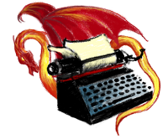
Naperwrimo.org
Local preparatory workshops
naperwrimo.org/events
Local write-ins (Library Crawl, games, challenges)
Also see the Chicago regional forum at chiwrimo.org
Notes:
TIM
Naperwrimo.org is not an official nanowrimo site, it’s one we own and Tim maintains, just for our region. There’s a bit more detail about our local events, as well as extra writing tips, notes from our workshops, and more.
challenge other regions - regional graphs (faces.naperwrimo.org)
community graph slide, special offers after this

Slide 15
Naperville Region – Community Graph
Notes:
TIM
Community graph allows you to see how you’re doing within the region, but you need to sign up on the faces page

Slide 16
Special Offers
When you sign up on the website, you become eligible for contests and for price breaks (and freebies!) on writing software, and copies of your book
Notes:
CB
Remember: Need examples/explanations of these for talking notes!!!
There are numerous price breaks on products you might like, sometimes on an item you sampled during NaNoWriMo: it’s how I got Scrivener.
Others: CreateSpace, Blurb or LuLu book, Scrivener, PROPS: books
there are special offers for all participants and there are prizes for winning; there's a difference!
NEED MORE EXAMPLES AND/OR DETAILS FOR MY TALKING NOTES!

Slide 17
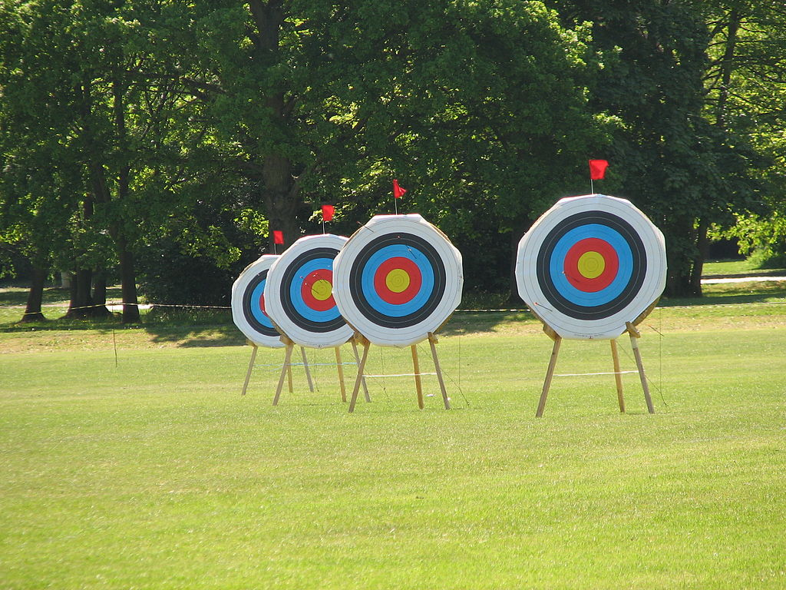
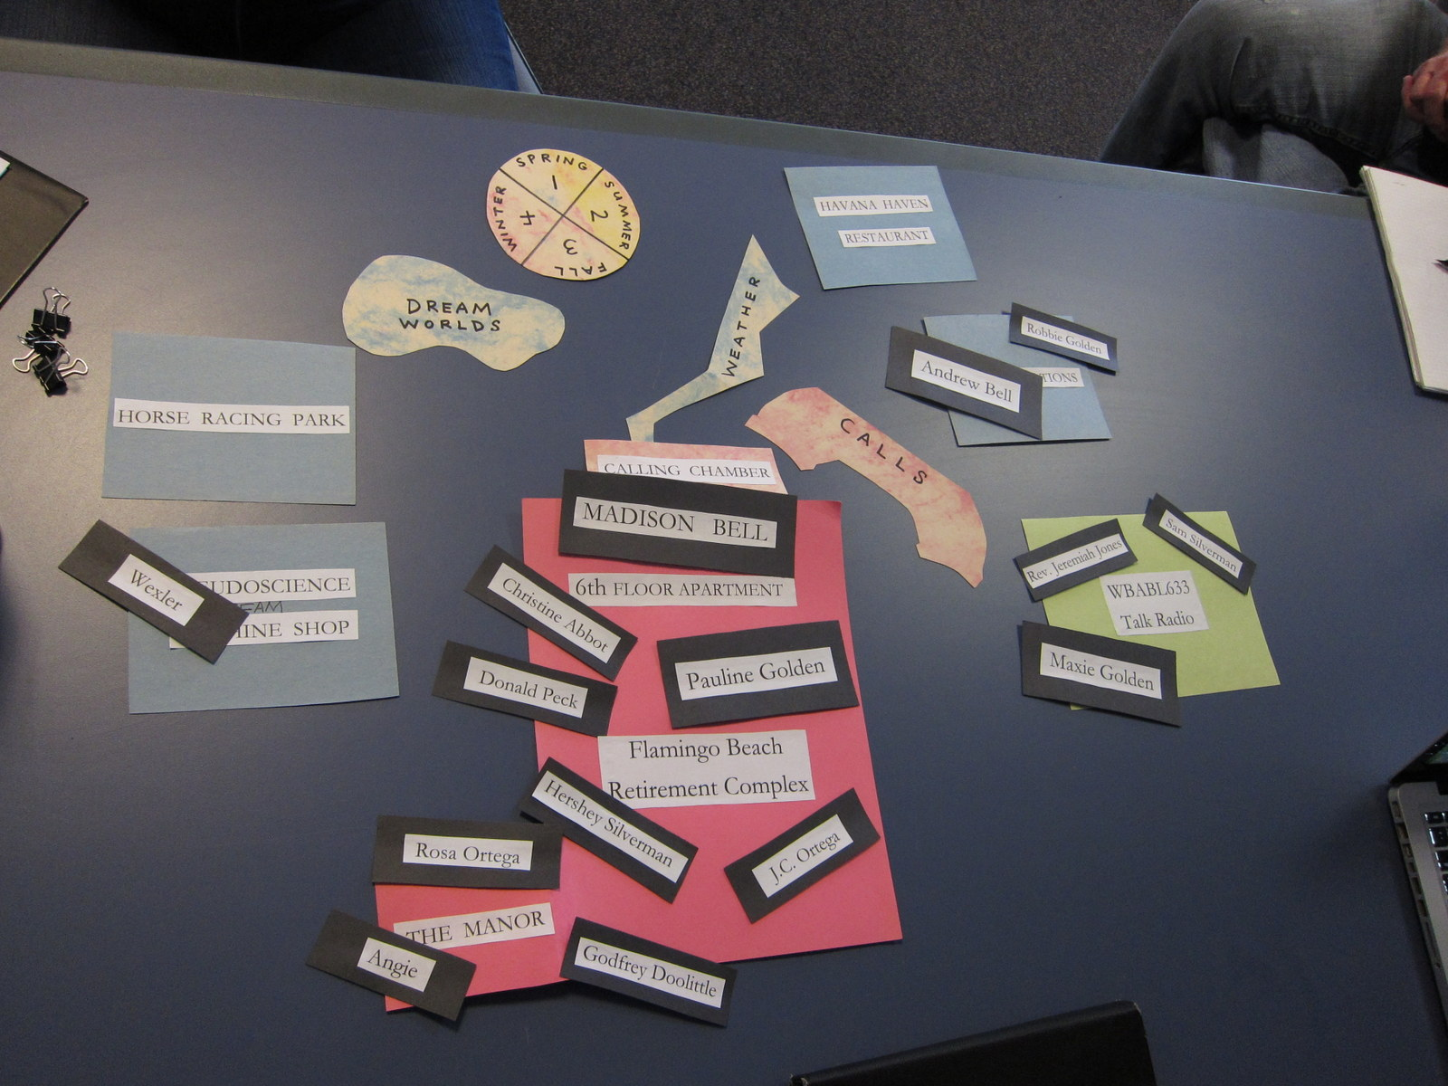
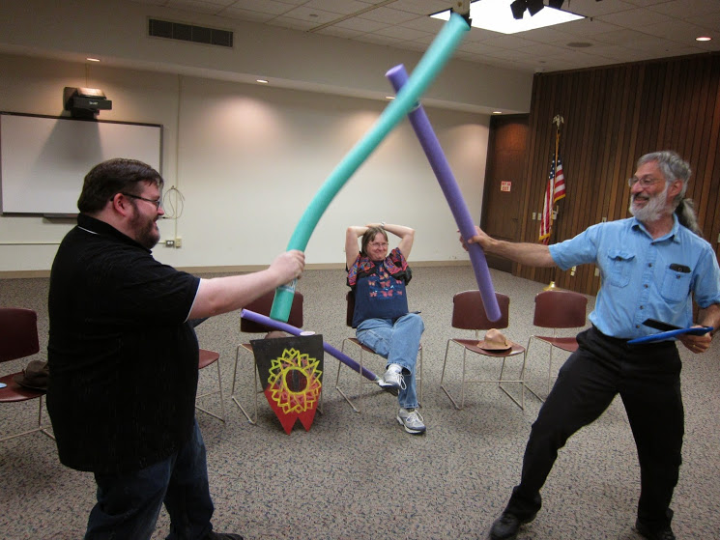
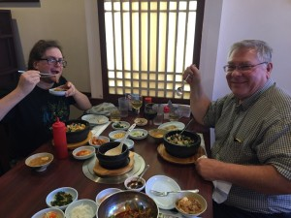
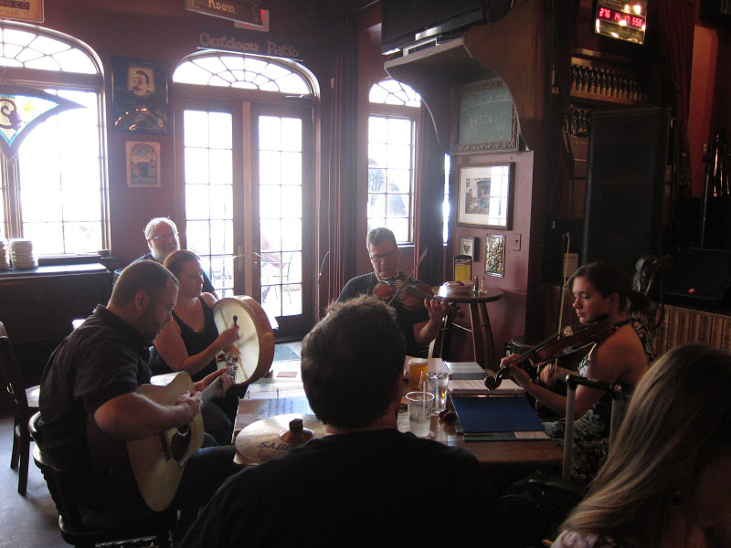
NaNo = novel writing + (social) = (fun)
Archery path
Story walls
Shakespeare
Readers’ Theatre
Asian path
Irish music at Ballydoyle
Though how much social you do is entirely up to you...
Notes:
CB (5 minutes)
The Writing Journey is our year-round writing group (separate from NaperWriMo but drawing from NaperWriMo participants. Here’s some of the fun we’ve had:
CLICK 1- Story walls are more work than social (though presentations, like the one above, can be entertaining) : anyone who hits a snag or otherwise wants feedback on a work in progress is welcome to present a story wall, where they can solicit suggestions from others
2- Shakespeare reader’s theatre, which we started after hearing about the genesis of Joss Whedon’s film of Much Ado About Nothing. A creative way to fill the well and get together with others
3- Archery path – um, research? Again, a way to do something different
4- Asian path – learn about other cultures (and eat)
5- Sometimes we learn about other cultures and drink! One of our members is a violinist who plays with an Irish seisún band. We’ve gone to hear them play.
We’ve also publshed short story anthologies and organized mini-writing retreats, writing trips to the arboretum and art institute, theatre and movie outings, game nights; whatever enough people have an interest in doing.
6- You can do everything, a couple of things, or nothing.
The social aspect of The Journey is muted in November during NaNoWriMo. We do have the bookend parties, Kick-off(October) and TGIO (December), and there is a mid-month meetup for dinner. But mostly in November we write.
We host write-ins, where people get together at a library or coffee shop for 2-3 hours and write together. There’s also an all-day write-in which tends to be more social than most write-ins, which are usually only a few hours.
Here’s an example of one activity we have at write-ins: NEXT: Word War! (TIM)

Slide 18
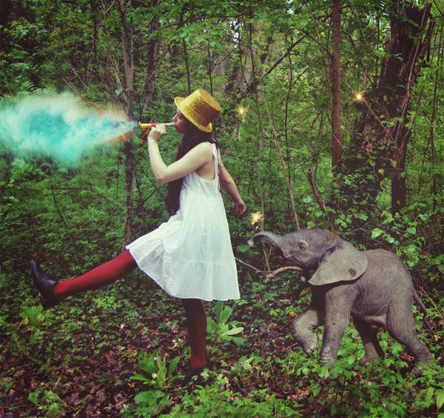
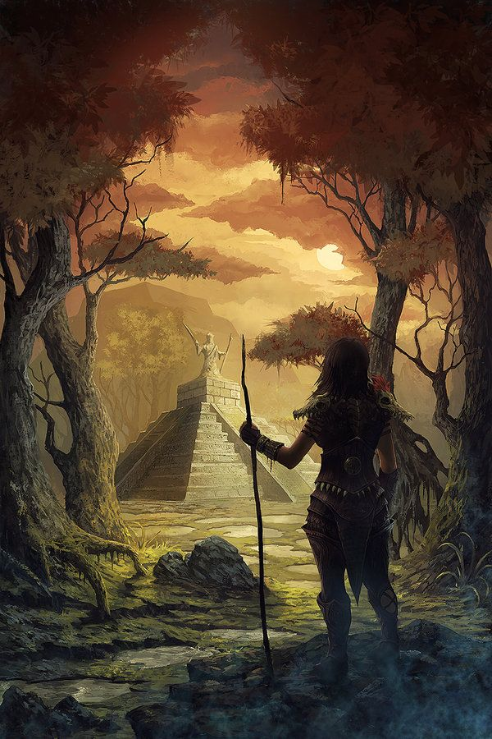
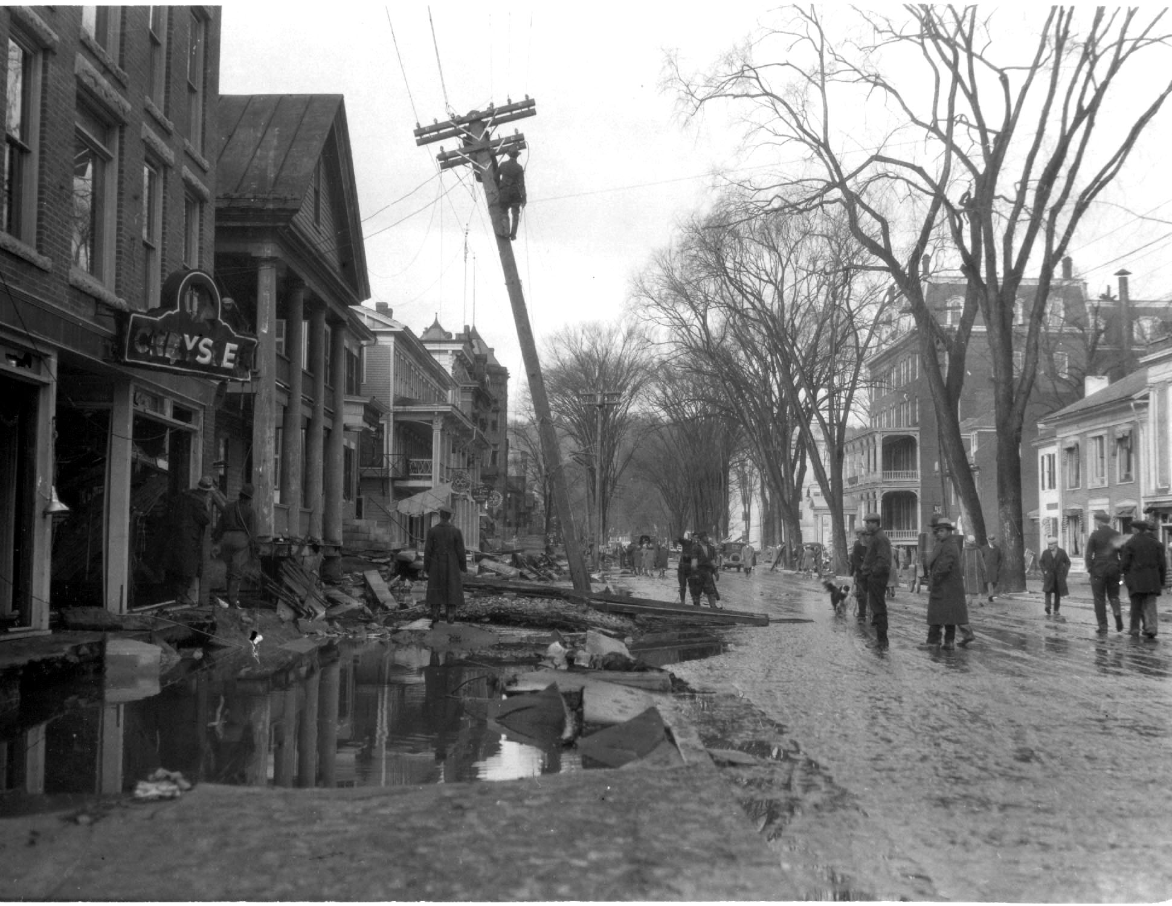
Word War!
Notes:
TIM
A word war is a timed writing activity
Write for 7 minutes either from your work-in-progress or one of the images provided
After writing: Count your word total
(Award prizes to the top 3 finishers)
What did you think of this exercise? Did you come up with anything you like and can use later? Allow three people to read what they wrote and/or respond to the exercise. No wrong answers. Some people find them motivating and other people don’t participate but just continue to write at their own pace. One reason they’re great at write-ins: you know for sure the room is going to be quiet for the length of the word war!
Next: NaNo Feud! (start music: CB runs this one while Tim writes on white board)

Slide 19
Category 2:
Free or commercial tools for planning, organizing & writing your novel
Notes:
Music (started after previous slide)
Timing: same as Category 1, Two minutes? Five?
CB: what helps you sit down to write? Stay on task? Keep ideas, characters, settings, notes, and written sections organized?
Tim: writes answers and tick marks (don’t erase tick marks per side); takes picture of board before erasing
(answers on next slide)

Slide 20
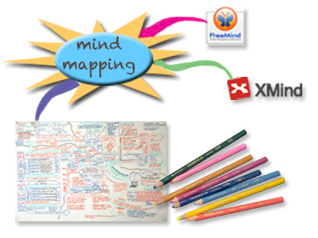
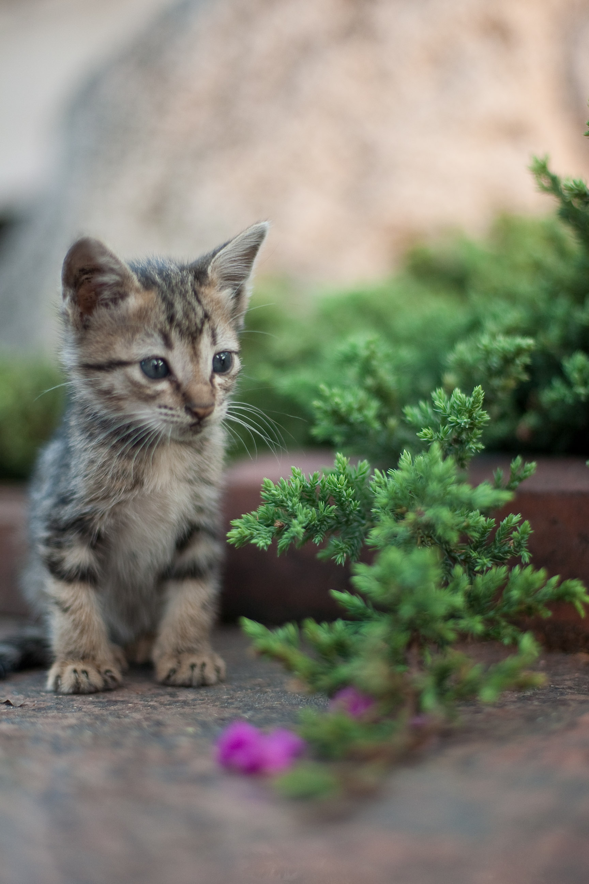
Free or commercial tools for planning, organizing & writing your novel
Written? Kitten!
Sticks & Carrots
Notes:
CB
Before this section: Solicit answers, using the easel and post-it notes. Some people will likely come up with tools we haven’t mentioned – ask for more information if they’re not shown in this presentation
10 minutes – total for this slide and the next
CLICK 1 -Mind mapping – there are various online tools for this, including Freemind (called Freemind because it’s free!) and Xmind (free and paid versions). And there’s also paper and pen or pencil, though that may be harder to keep track of.
CLICK 2- Sticks
CLICK 3 – Carrots
CLICK 4 - Focus editors – ways of cutting down on distractions while you write: much less focus writeroom/darkroom (depending on whether you have a mac or windows machine), q10, writemonkey, Creawriter (prettier) Then there are online tools to keep you writing at a certain pace: Write or Die, which sets up consequences if you don’t continue to type at a certain pace (you set this yourself). For something less punitive, there’s Written? Kitten!, which rewards you with cute pictures of kittens, puppies or bunnies for achieving word count goals.

Slide 21
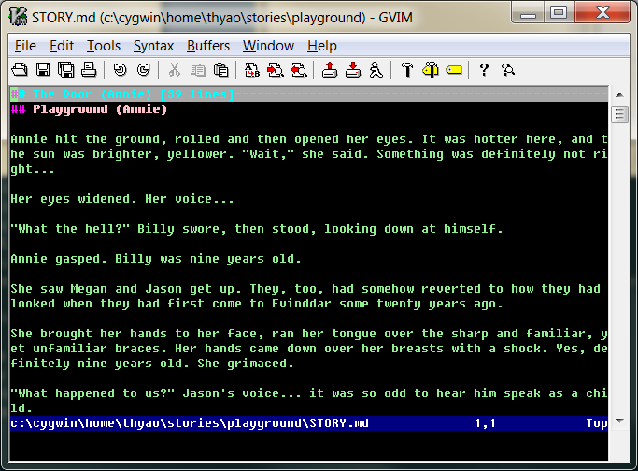
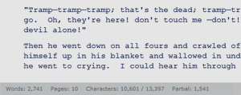
Tools for writing your novel: write and edit in simple text
Don’t get distracted by formatting while you are writing.
When you are ready, use pandoc to convert the markdown into other formats
XHTML, HTML5, and HTML slide shows using Slidy, reveal.js, Slideous, S5, or DZSlides.
Word processors: Microsoft Word docx, OpenOffice/LibreOffice ODT, OpenDocument XML
Ebooks: EPUB version 2 or 3, FictionBook2
Page layout formats: InDesign ICML
Outline formats: OPML
TeX formats: LaTeX, ConTeXt, LaTeX Beamer slides PDF via LaTeX
Other custom formats are possible
Notes:
TIM:
Write and edit your novel in a distraction-free text editor such as vim, emacs, notepad++ or Q10 (there are many others)

Slide 22
Tools for planning, organizing & writing your novel
Planning, writing, & exporting all in one
Free Office Suites
Notes:
CB (5 minutes, tops)
CLICK 1 - Planning, etc: Scrivener for Mac and Windows, Ywriter (Windows only); Storyist for Mac and iPad
CLICK 2 – Free Office suites – LibreOffice is a download, while with Google docs you can write and format directly online, and it saves your document for you to continue to work online; can download, but then you need a text editor or word processor in order to work offline. Which brings up a point. Have online backups: dropbox, google drive are two easy and free ways to do it.

Slide 23
Steps for planning, organizing & writing your novel
Many people, when asked how to write a novel, will offer this plan:
Step 1: Come up with an idea to write a novel
Step 2: Start writing your novel
Step 3: ...
Step 4: PROFIT!
Of course, this is not repeatable
Notes:
Click 1 – many people, when asked how to write a novel, will offer this plan
2- step 1
3- step 2
4- step 3
5- step 4
6- Of course, this is not repeatable

Slide 24
How do you start? Planning your novel
One approach: start with the back cover book blurb
100 words
Chapter 1
Chapter 2
Chapter 3
1000 words
Chapter 4
Chapter 5
Chapter 6
Chapter 7
Chapter 8
Chapter 9
5000 words
Etc.
Notes:
TIM (5-10 minutes)
From: http://www.pbs.org/pov/guiltypleasures/how-to-write-a-romance-novel-gill-sanderson.php
CLICK 1 - Start with a 100-word synopsis (in real, connected prose, not outline form) telling who the hero and heroine are (if you’re writing a romance), the novel’s time and place, sub-genre and mood.
2 - Expand to 1000 words, concisely covering the first meeting, the first problem (that becomes a bigger problem) the big climactic scene, the happy ending.
3 - Expand again, to about a tenth of your expected length, or 5000 words for a 50,000-word novel.
4 - Divide your story into chapters, writing in notes about what you want to include (though don’t start writing at full length yet; finish your planning in this stage)
Once this is finished, your actual novel-writing should come very quickly; no fear of writers block!

Slide 25
How do you start?
Q. What if you have so many ideas, you’re not sure which to choose?
A. Find out what your audience wants to read.
Five Story Pitches
1. An immigrant escapes poverty and abuse to illegally enter another country. In order to make a secure life for herself there, she must develop her abilities, overcome the prejudices of others and her own self-doubt and claim her own place in the world.
2. Legends of a Monster Queen who has gained control the monstrous ant-men who ravage her homeland lead humble villager Mary Lou to infiltrate the Monster Queen’s lair so she can end the Monster menace once and for all. But she finds the Monster Queen is more dangerous than she ever expected.
3. Gambler Slim Holloway has made a mostly comfortable life on the frontier by using his minor gift of knowing the cards in his opponents’ hands, but when members of a traveling medicine show rescue him from a deadly misadventure and recognize his powers, he can only repay them by becoming a better person.
4. Time Traveler Terry has discovered a historical person who knows how to perform magic. Terry must bring this lost art to his time in order to prevent the end of life on Earth, but an unsuspected traitor in his crew may strand them all in the past for the rest of their lives.
5. Tracy’s life with her father was almost perfect once he overcame his drug addiction. When he reunited with his ex-wife, the mother who abandoned Tracy years ago, Tracy knew they might not find it quick or easy to become a happy family, but she never expected that her own mother would turn on her when her father dies unexpectedly, dashing all her hopes of acquiring a good education and a happy future.
Notes:
CB (5 minutes)
You may already know what you want to write.
One idea, if you can’t decide, is crowdsourcing:
I was full of ideas one year and couldn’t decide which story I wanted to concentrate on in November. So, using a short blurb (like the one used in the previous planning document) I created a survey on the NaNo website and linked to it on my Facebook page, asking people to pick their favorite among my story ideas, or rank them, and comment if they felt so inclined.

Slide 26
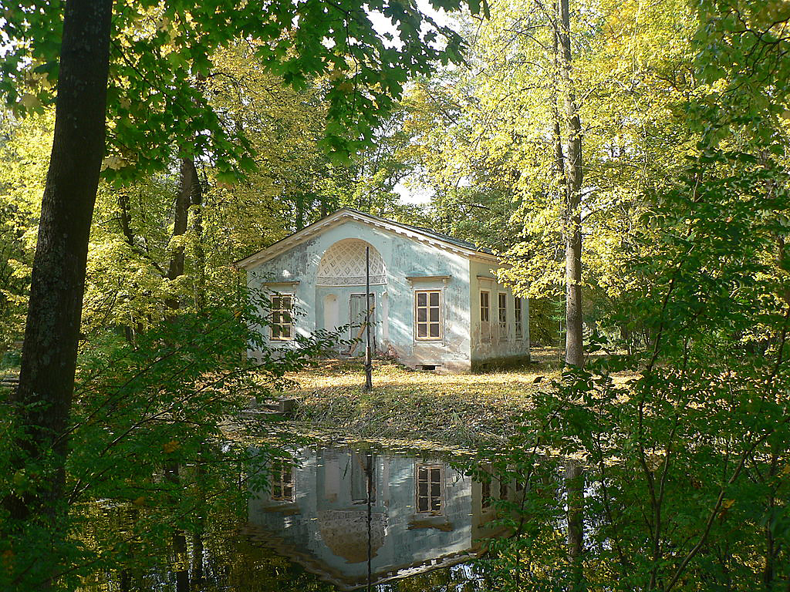
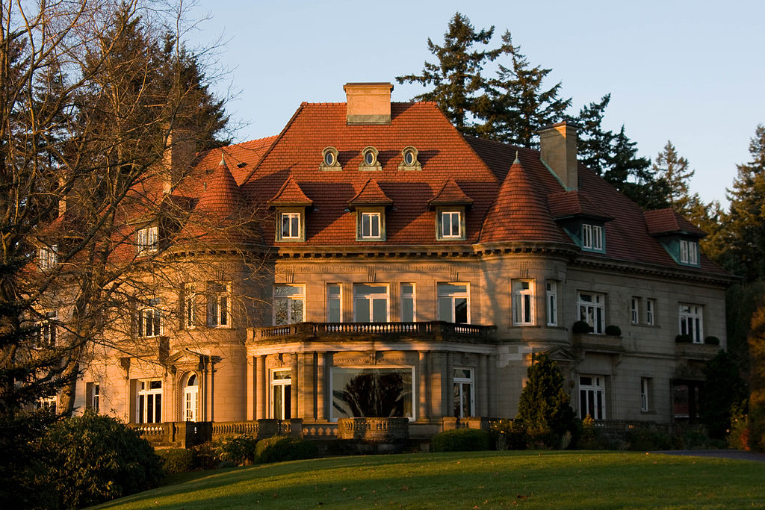
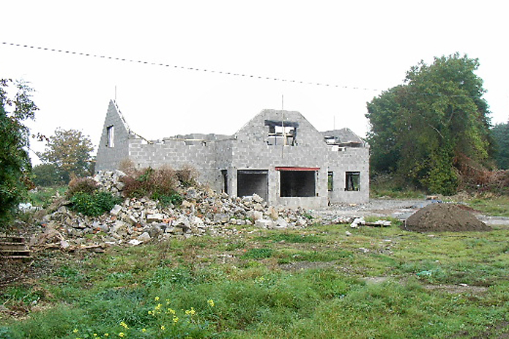
How ambitious should you be?
Notes:
Tim
Decide how much you want to accomplish in November
On start: image of mansion
Click 1: mansion dissolves
Click 2: roofless house with rubble appears
Click 3: house dissolves
Click 4: little house in the woods appears

Slide 27
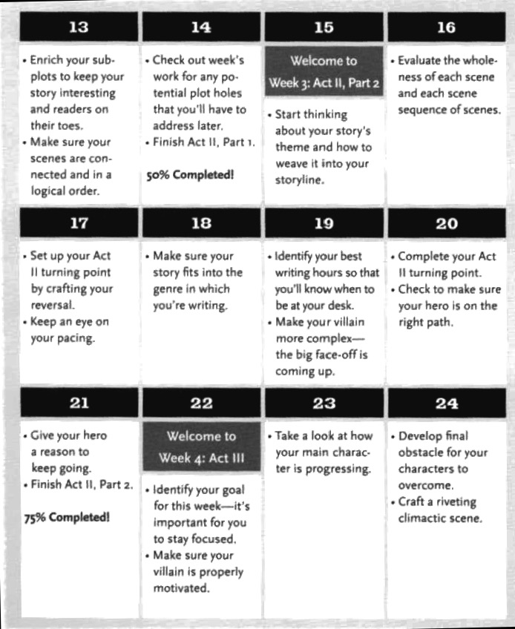
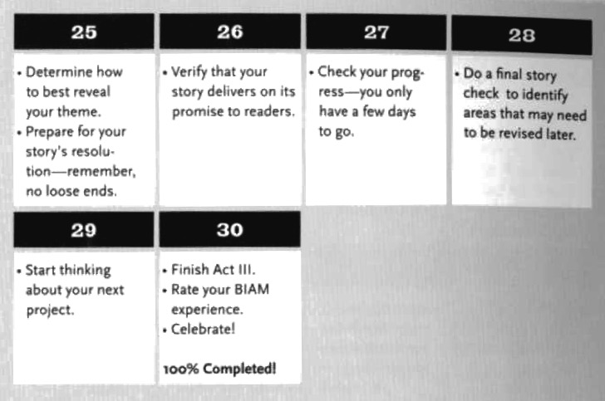
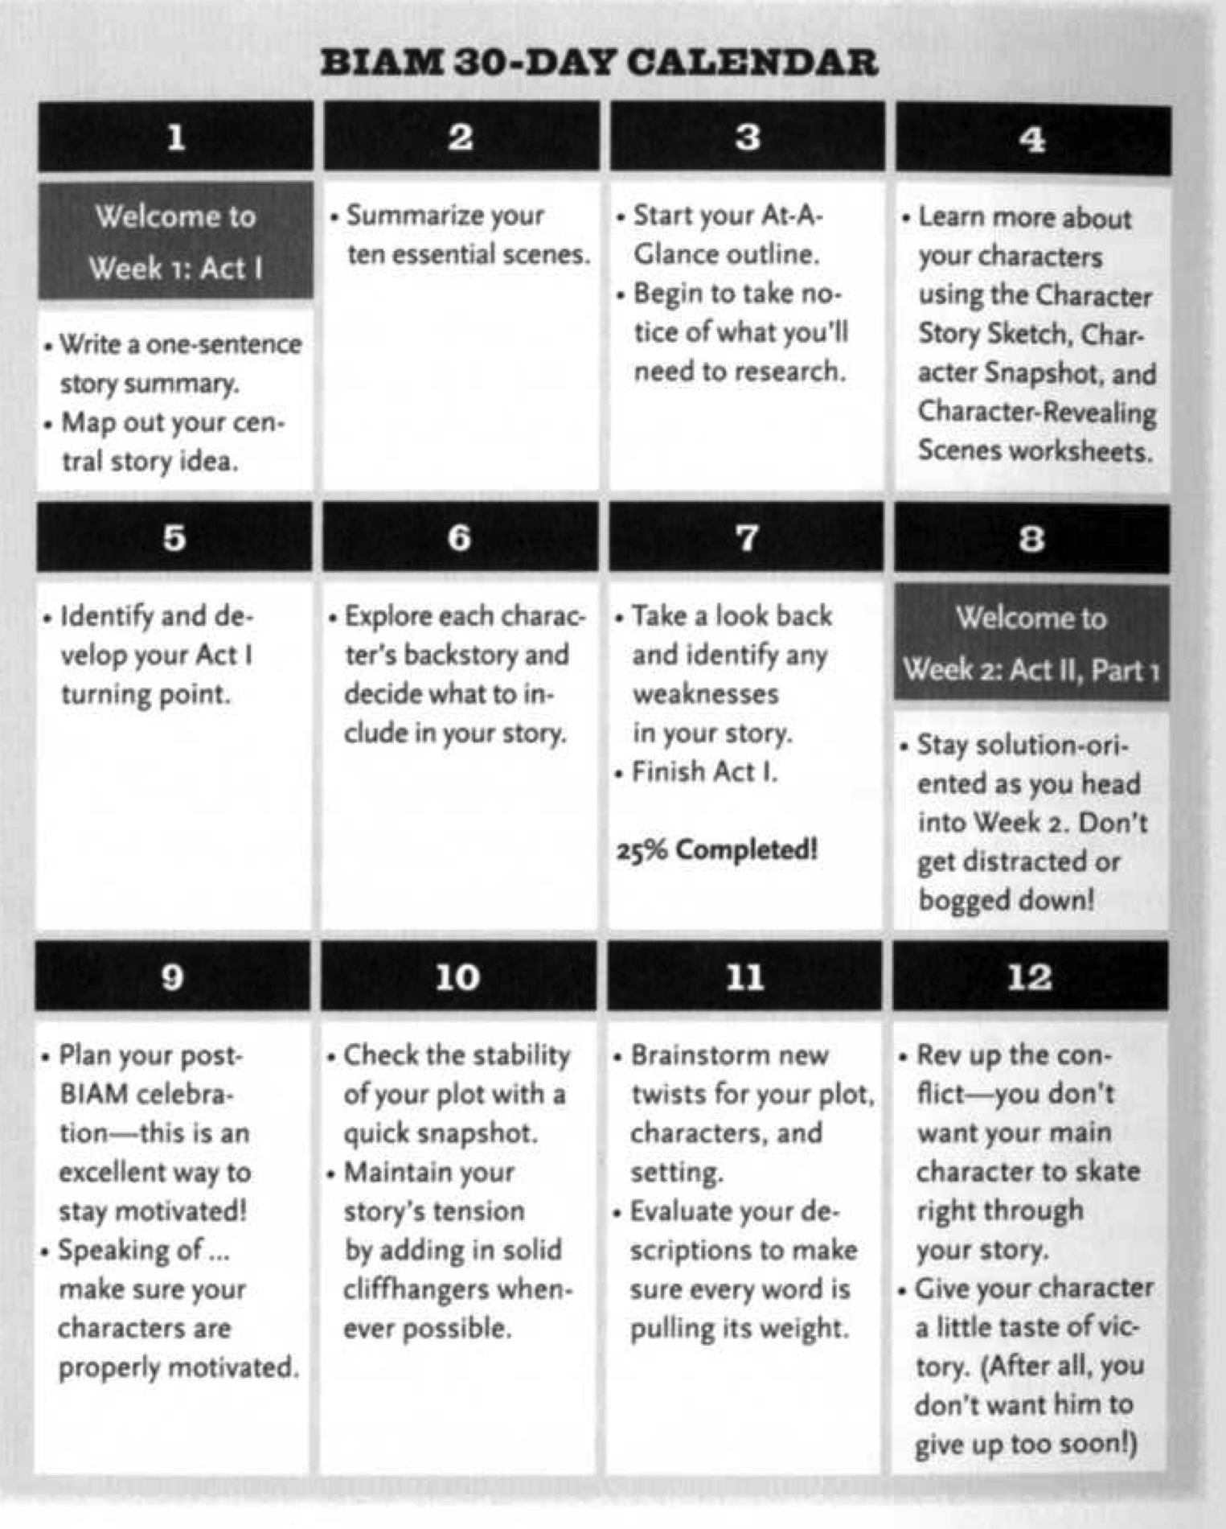
How do you finish?
Use checkpoints to stay on track
Aim to reach the exciting conclusion in the last week
Keep your core story lean
Notes:
CB (5 minutes)
Click 1- Checkpoints for novel progress (to complete the novel within 30 days); graphic is from Victoria Lynn Schmidt’s Book in a Month system.
Click 2- Aim to reach the exciting conclusion in the last week. You can even do the Monty Python trick: scene missing. Put in brackets a quick sketch of what needs to happen to make the conclusion work.
Click 3- Keep your core story lean; you can always add subplots and even characters later
Why would you want to finish your novel within NaNo? (easier to flesh out than to finish outside NaNo when you no longer have the group energy; you also know what you’re working towards)

Slide 28
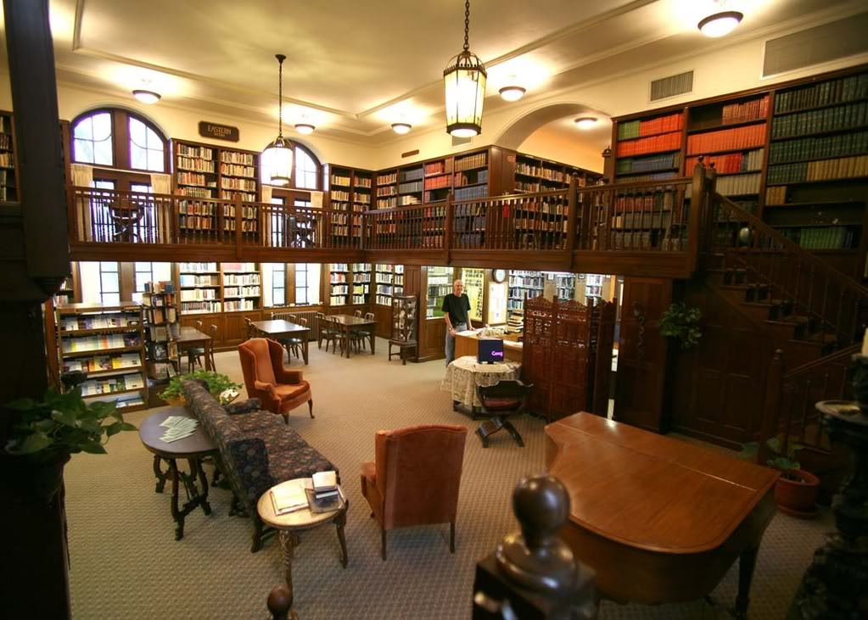
Writing Exercise: Use your senses
1 place
3rd person
(tight POV)
5 senses
10 minutes
0 other humans
Notes:
CB (10 minutes/ credit Mary Robinette Kowal) Theosophical Society It’s a basic exercise, but sometimes it helps to go back to basics
Choose a space to write about. It can be the room we’re in, a setting from a novel you’re planning, or some room you’re extremely familiar with.
Describe it using third person. You are the point of view character, but instead of writing in first person, write in third.
Write constantly for ten minutes. Keep your hand(s) moving.
Try to use all five senses. Include what might be heard, smelt, felt, seen, and tasted.
Do not describe people in the location, except where they cause the room to react. For instance, someone shifting in their chair would cause a squeak in the room.
Write for 10 minutes.
Prizes (3?) for various prizes: most words written (making sure to award people who didn’t already win the first word war), Someone who likes what they wrote? Someone who reads favorite 1-2 paragraphs of what they wrote?
How did this exercise strike you? Anything useful?

Slide 29
Writing Exercise: Character Viewpoint
Create a character
physical state?
job?
emotional state?
other interests
or hobbies?
gender?
Using the writing you just completed, have your character enter that space. What does the character see, hear, smell, feel, taste? How does (s)he feel about it?
Write in limited 3rd person POV constantly for 5 minutes
Notes:
10 minutes: 5 for writing plus 5 for discussion below, covering both sections) still in third person
CB: FIX SILHOUETTE IMAGE
Create a character, or use one from a WIP
After: Ask if anyone made any discoveries while doing this writing. Did anyone surprise themselves? Does anyone want to read a paragraph? (Don’t let this take more than 5 minutes)
Prize to reader(s) or person who talked the most
Next: START MUSIC

Slide 30
Category 3:
How you can succeed at NaNoWriMo
Notes:
Tim (less than 10 minutes); CB write answers and tick marks
What else can you do to make it easier to keep writing and make your word count or story goals?
Solicit answers; some people will likely come up with tools we haven’t mentioned – ask for any extra needed information if they’re not shown in this presentation
Our answers on next slide

Slide 31
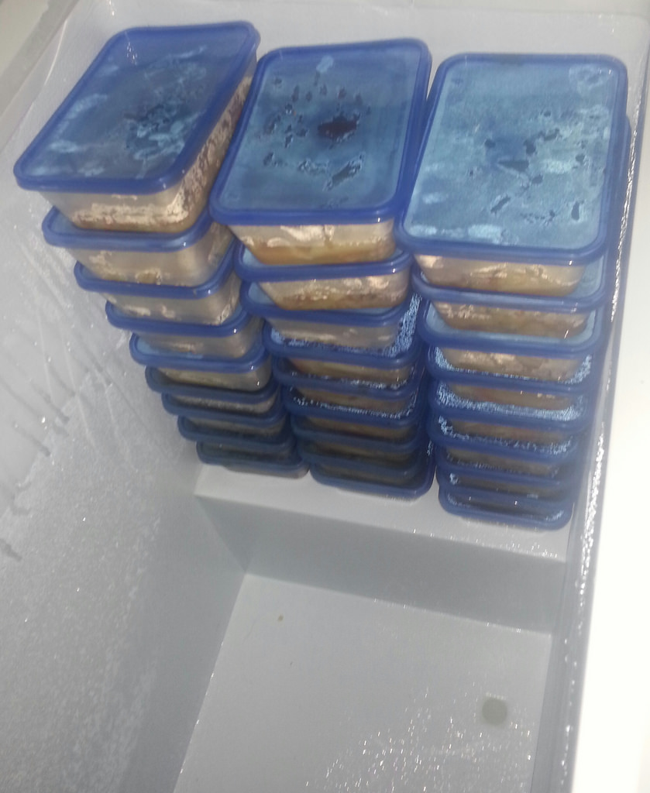
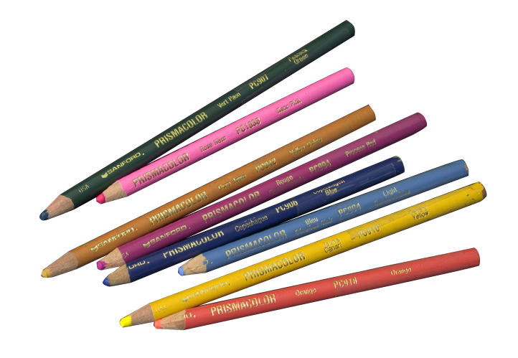
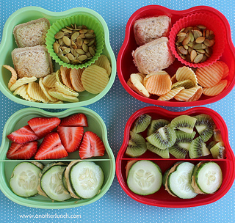
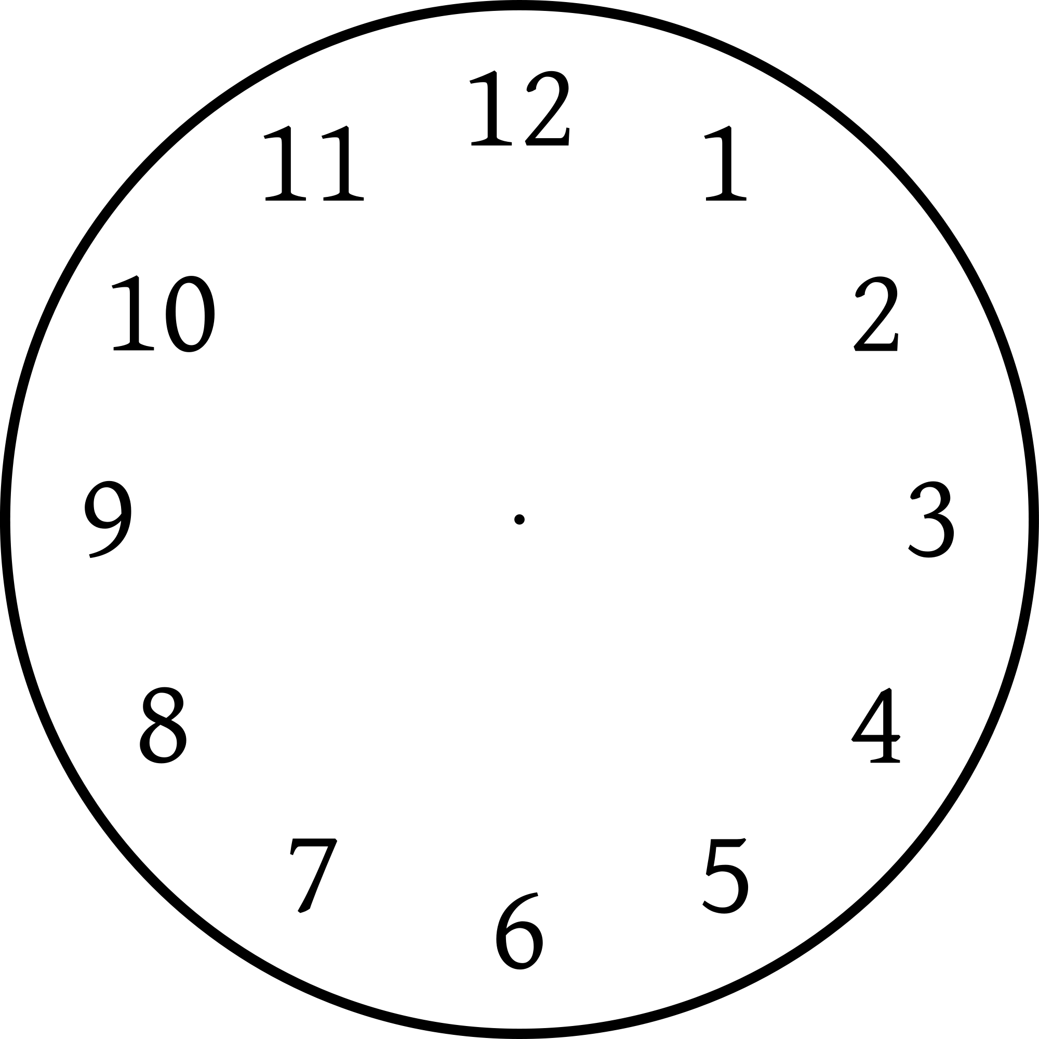
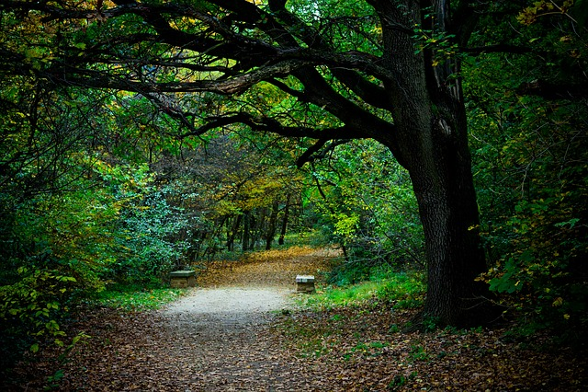
Third (and Final) Category: How you can succeed at NaNoWriMo
Notes:
10+ minutes
1- Plan ahead: Clear your schedule. Put dinners in the freezer ahead of time.
2- Rewards and motivational items to have while writing:
3- music-for-writing-by, new office supplies or drawing materials,
4- snacks.
5- Creative headspace- music, environment (taking walks, driving, jogging, physical activities that don’t require a lot of mental attention).
6- Taking notes when ideas come
7- Habit of writing (setting aside time of day)
8- (clock dissolves) Rewards like my homemade graphics (props!); refer to nano artisans for cover design or other motivational art
Extra rewards: Props: Novelistas poster, writing tiara, Nano USB bracelet and other prizes from write-ins;

Slide 32
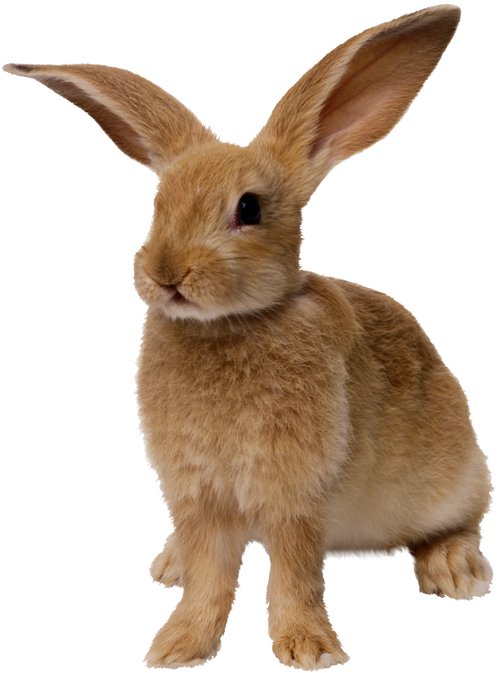
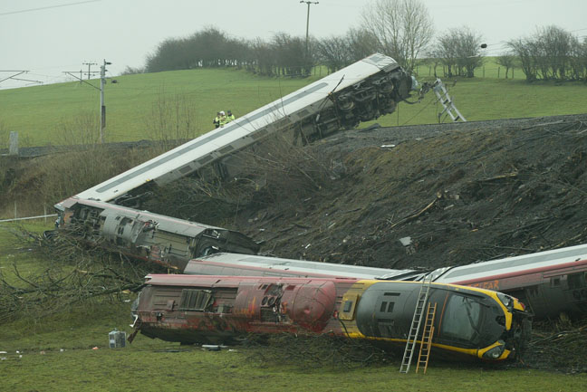
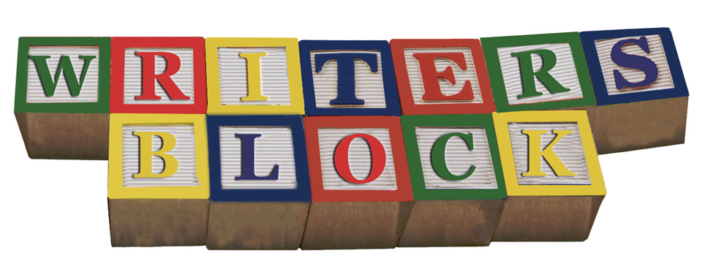
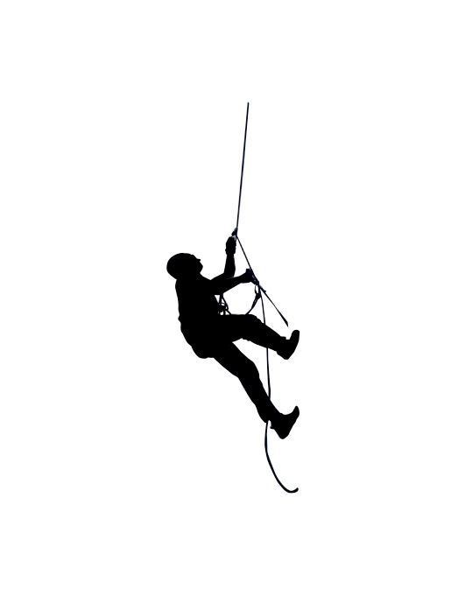
Don’t get derailed! Possible problems
Mid-novel slump
Failing to finish
Notes:
ON start: train derailment image
Solicit answers and let people talk; some people will likely come up with tools we haven’t mentioned – ask for any extra needed information if they’re not shown in this presentation
Click 1- train disappears
Click 2- writer’s block
Click 3- plot bunnies - ideas that pop up,
Click 4- (more bunnies) appear like magic; multiply like rabbits; can distract you from your framework; need to balance accepting new ideas with being sure to finish in November; save the plot bunnies to possibly use for later but don’t let them change your initial direction (unless it is intentional!)
Click 5- mid-story slump (why is my novel suddenly so boring? I’m stuck)
Click 6- Technical difficulties, computer crashes
Click 7- failing to finish

Slide 33
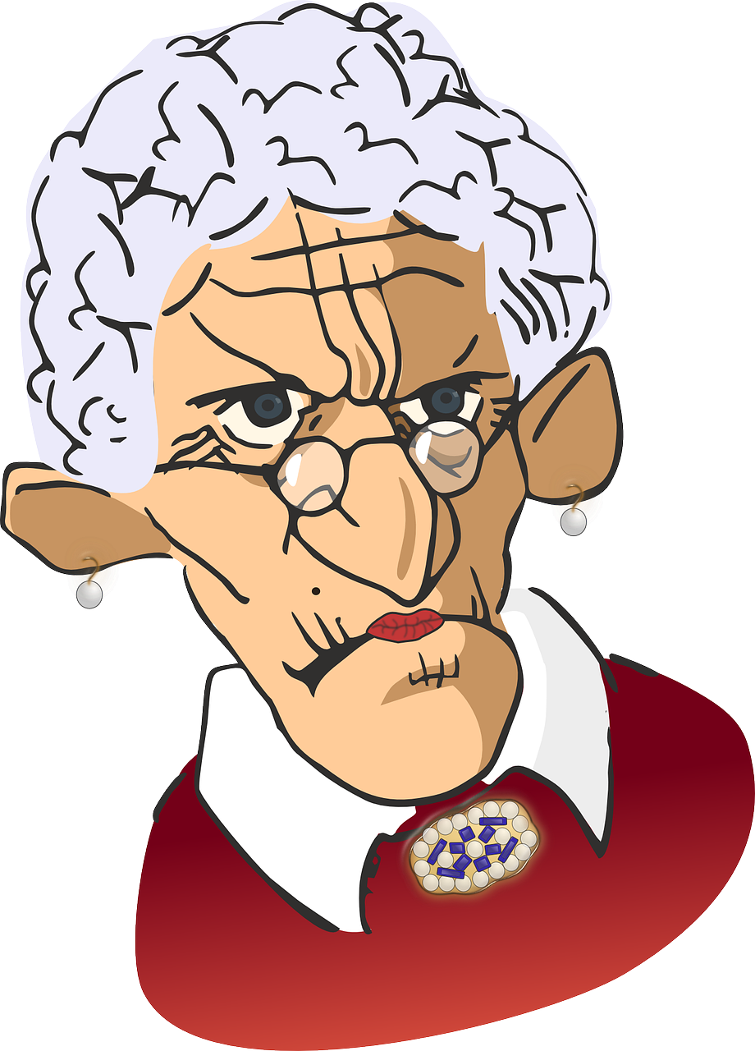
Don’t get derailed! Some strategies
Writers Block/ Mid-novel Slump?
Power through (write-ins might help...)
Write the next interesting scene
Seek creative headspace/physical activity
Only stop when you can’t wait to write what comes next
Save
your
work!
Story walls
Notes:
Click 1: Put plot bunnies in a folder/separate document, or file; you can save those ideas for later
2- mid-novel slump around the second week. Why is my novel suddenly so boring? Note: different strategies work for different people or work for the same person at different times
3- power through/write-ins
4- write next interesting scene
5- creative headspace time low level physical activity
6- never stop at the end of a scene; stop when you absolutely have to write what happens next
Click 7: Internal editors (can be a problem if you have writer’s block or mid-novel slump)
Click 8: Jail internal editor until December 1.
9- Failed to finish? Decide to finish in November even if you have to list what happens (sketch it out; draw from your outline--you will then know what you need to write later)
Help make sure you finish in November by making your novel is slim enough to complete within a month (leave out subplots and even characters for later)
Even if you kept the novel slim enough to complete, you might still need to add things or even get to the ending. Keep working with others who need to finish. If you’re stuck or looking for feedback, try continuing to work with novel-writing buddies who also failed to finish
10: Story walls with other writers; we do them monthly at the Journey
And finally, don’t forget to
11: SAVE YOUR WORK! Early and often and in multiple places.

Slide 34
To Sign up for National Novel Writing Month
Go to nanowrimo.org
Find our region at naperwrimo.org and nanowrimo.org/regions/usa-illinois-naperville
Calendar of our region’s events is at naperwrimo.org/events
The Chicago region has a website at chiwrimo.org
Notes:
CB does this
Handouts to include at least the links above; possibly a link to this presentation? Link to the public Journey site, or not? Link to ChiWriMo, or not?
LAST SLIDE OF PRESENTATION; The rest are just extras

Slide 35
Extra: How do you start?
The Snowflake Method
Step 1: One hour. Write a one-sentence description of what happens in the novel – 15 words or less. No names; big picture/personal picture; read NY Times bestseller blurbs for ideas on how to do this.
Step 2: One hour. Expand to a paragraph describing story setup, major disasters; the ending.
Step 3: Major character summaries. Include each character’s name, storyline, motivation, goal, conflict, epiphany. Revise steps 1 and 2 if you need to.
Step 4: Expand the step 2 summary paragraph, now writing a paragraph for each sentence.
Steps 5-9 expand the story in some of the same ways as step 4, cycling back to fill in more about characters, story threads, etc. There are also some steps that only apply to some writers (for example, if you need to turn a synopsis into your publisher in order to get the go-ahead.
Step 10 is when you begin to write your novel, which should now flow fairly easily.
See: The Snowflake Method

Slide 36
Additional Links
Jamie Gold: Write Romance? Get Your Beat Sheet Here!: http://jamigold.com/2012/11/write-romance-get-your-beat-sheet-here/
Randy Ingermanson: The Snowflake Method For Designing A Novel: http://www.advancedfictionwriting.com/articles/snowflake-method/
Novel in 30 days worksheet: http://www.writersdigest.com/writing-articles/by-writing-goal/write-first-chapter-get-started/novel-in-30-days-2011
Mind mapping
Xmind (https://www.xmind.net/ )
freemind (http://freemind.sourceforge.net/wiki/index.php/Main_Page )
Focus editors and basic text editors/markdown
(DarkRoom - http://dark-room.en.softonic.com/
Q10- http://www.baara.com/q10/
writemonkey- http://writemonkey.com/
focuswriter- http://gottcode.org/focuswriter/ )
Vim (http://www.vim.org/about.php and also http://naperwrimo.org/vim) (or emacs- https://www.gnu.org/software/emacs/emacs.html )
markdown (https://daringfireball.net/projects/markdown/)
pandoc (http://pandoc.org/README.html )
Planning, writing, and exporting all in one:
Scrivener- http://get.esellerate.net/get/ALP015439528/default.htm?skuid=SKU81634174866&affid=AFL5515288049&at= (Windows and Mac)
ywriter- http://www.spacejock.com/yWriter5.html (Windows only)
Storyist http://storyist.com/index.html (Mac, iPad)
Free Office Suites
Libreoffice free office suite (https://www.libreoffice.org)
Google docs (allows you to write and save online): https://drive.google.com
Online Sticks/Carrots
Write or Die: http://writeordie.com/
Written? Kitten! http://writtenkitten.net

Slide 37
Image Credits
Slide 4
Water for Elephants by Sara Gruen, published by Algonquin Books of Chapel Hill. Design by Jacky Woolsey
Shades of Milk and Honey by Mary Robinette Kowal, published by Tom Doherty Associates, LLC
Anna and the French Kiss by Stephanie Perkins, published by Penguin Group (USA)
The Darwin Elevator by Jason M. Hough, published by Del Rey
The Night Circus by Erin Morgenstern; published by Doubleday. Jacket design by John Fontana. Illustration by Helen Musselwhite
Slide 5
Golden Gate Bridge - Wikimedia Commons Image by Rich Niewiroski Jr. Creative Commons Attribution 2.5 Generic License
Cartons on dolly - Microsoft clip art
Writing Hand and Young Writers logo - National Novel Writing Month images
Slide 6
Snowstorm - Wikimedia Commons image courtesy Al Jazeera English. CC 2.0 License
Kanban -screen shot from KanbanFlow web site
Gifts - torange.us - CC 4 License
Turkey - Microsoft clip art
Slide 7
Pirate – caricature by J.J. - CC BY-SA 3.0
Slides 8-13
Screen shots of National Novel Writing Month pages
Slide 14
Screen shots of naperwrimo.org pages

Slide 38
Image Credits
Slides 15-16
Screen shots from National Novel Writing Month pages
Slide 17
Writing Journey photographs by Tim Yao
Slide 18
Girl with elephant – Dara Scully
Surviving the 1927 flood – Young Writers Project Archive
Legacy of Moth – Peter Ortiz
Slides 20-22
Screenshots and logos: Freemind, XMind, WriteOrDie Writemonkey, OmmWriter, CreaWriter, Scrivener, YWriter, Storyist, LibreOffice, Google Docs
Slide 25
Screenshot from Facebook
Slide 26
Unfinished house: http://www.geograph.org.uk/photo/581673 / Image Copyright JP. This work is licensed under the Creative Commons Attribution-Share Alike 2.0 Generic Licence. To view a copy of this licence, visit http://creativecommons.org/licenses/by-sa/2.0/ or send a letter to Creative Commons, 171 Second Street, Suite 300, San Francisco, California, 94105, USA.
Pittock Mansion: Photo by DAVID ILIFF. Public Domain image. License: CC-BY-SA 3.0
Small house: Author: O-Fly. This file is licensed under the CC Attribution 3.0 Unported license.

Slide 39
Image Credits
Slide 28
Theosophical Society of America
Slide 31
Sketchbook: author: Sanya, public domain image
Red notebook: Author: Zedlik. License: CC-BY-SA 3.0
Smart phone: Pixabay, released under Creative Commons CC0.
Open book vector: public domain image
Slide 32
Train derailment: Lawrence Clift, CC BY-SA 3.0
Bunny – Microsoft clip art
Mountain climber: public domain image. "Kamar Zard Buzhan - Nishapur 1" by Sonia Sevilla - Licensed under CC0 via Commons
Slide 33
Stern old woman. Pixabay, released under Creative Commons CC0.
File folder. Christian Guthier CC2 license

Slide 40
Backups/Notes/Links/Credits
Image Credits
Unfinished house: http://www.geograph.org.uk/photo/581673 / © Copyright JP and licensed for reuse under thisCreative Commons Licence
Mansion: Photo by DAVID ILIFF. License: CC-BY-SA 3.0
Pittock mansion: (Geremia) - I, the copyright holder of this work, release this work into the public domain. This applies worldwide. grant anyone the right to use this work for any purpose, without any conditions, unless such conditions are required by law.
Small house: Author: O-FlyThis file is licensed under the Creative Commons Attribution 3.0 Unported license.
https://creativecommons.org/licenses/by/3.0/deed.en
sketchbook:
author: Sanya
I, the copyright holder of this work, release this work into the public domain. This applies worldwide. In some countries this may not be legally possible; if so: I grant anyone the right to use this work for any purpose, without any conditions, unless such conditions are required by law.
Red notebook: Author: Zedlik. License: CC-BY-SA 3.0
Smart phone: Uploaded Images and Videos on Pixabay are released under Creative Commons CC0. To the extent possible under law, uploaders of Pixabay have waived all copyright and related or neighboring rights to these Images and Videos. You are free to adapt and use them for commercial purposes without attributing the original author or source. Although not required, a link back to Pixabay is appreciated.
Open book vector: The person who associated a work with this deed has dedicated the work to the public domain by waiving all of his or her rights to the work worldwide under copyright law, including all related and neighboring rights, to the extent allowed by law. You can copy, modify, distribute and perform the work, even for commercial purposes, all without asking permission.
Mountain climber: public domain image. "Kamar Zard Buzhan - Nishapur 1" by Sonia Sevilla - Own work. Licensed under CC0 via Commons - https://commons.wikimedia.org/wiki/File:Kamar_Zard_Buzhan_-_Nishapur_1.jpg#/media/File:Kamar_Zard_Buzhan_-_Nishapur_1.jpg
Train derailment: This work is free and may be used by anyone for any purpose. If you wish to use this content, you do not need to request permission as long as you follow any licensing requirements mentioned on this page.
Wikimedia has received an e-mail confirming that the copyright holder has approved publication under the terms mentioned on this page. This correspondence has beenreviewed by an OTRS member and stored in our permission archive. The correspondence is available to trusted volunteers as ticket #2007022710013697.
If you have questions about the archived correspondence, please use the OTRS noticeboard. Ticket link:https://ticket.wikimedia.org/otrs/index.pl?Action=AgentTicketZoom&TicketNumber=2007022710013697
Credit the author: "VirginPendolinoDerailment" by Lawrence Clift - http://www.lawrencecliftphotography.co.uk/images/ila/1553_847036.jpg. Licensed under CC BY-SA 3.0 via Commons - https://commons.wikimedia.org/wiki/File:VirginPendolinoDerailment.jpg#/media/File:VirginPendolinoDerailment.jpg

Slide 41
Backups/Notes/Links/Credits
Photograph credits
Slide 32
Computer crash: Pixabay: https://pixabay.com/en/broken-computer-emoticon-smiley-153601/
Stern old woman: Pixabay: Using Images and Videos
Uploaded Images and Videos on Pixabay are released under Creative Commons CC0. To the extent possible under law, uploaders of Pixabay have waived all copyright and related or neighboring rights to these Images and Videos. You are free to adapt and use them for commercial purposes without attributing the original author or source. Although not required, a link back to Pixabay is appreciated.
Limitations:
a) Images and Videos depicting identifiable persons may not be used for pornographic, unlawful or other immoral purposes, or in a way that can give a bad name to people, or to imply endorsement of products and services by those persons, brands, organisations, etc.
b) Since Pixabay does not require a written Model Release for each Image or Video that shows identifiable people, We cannot guarantee that You will be able to use the Content for any purpose You like. If there is a Model Release, We do not make warranties whatsoever as to the legality or validity of it.
c) Furthermore, certain Images or Videos may be subject to additional copyrights, property rights, trademarks etc. and may require the consent of a third party or the license of these rights. Pixabay does not represent or make any warranties that it owns or licenses any of the mentioned, nor does it grant them. It's your sole responsibility to make sure that You have all the necessary rights, consents and licenses for the use of the Content.
You use the Website, its Images and Videos at your own risk.
File folder: Christian Guthier CC2 license

Slide 42
To Do
Slide 4: ADD ANECDOTES? See if there are author comments on Nano site, maybe in pep talks
Slide 16, Need examples/explanations of some of these premiums
Review images and improve quality where possible
Review/fix fonts throughout
Review animations
Provide image credits
Provide links
Always: Bring VGA adapter

